Slide 1

Click to get started…
Notes:
(Next Slide)

Slide 2
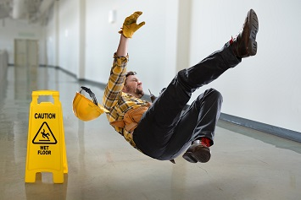
SLIPS, TRIPS, AND FALLS
Notes:
SLIPS, TRIPS, AND FALLS
(Next Slide)

Slide 3
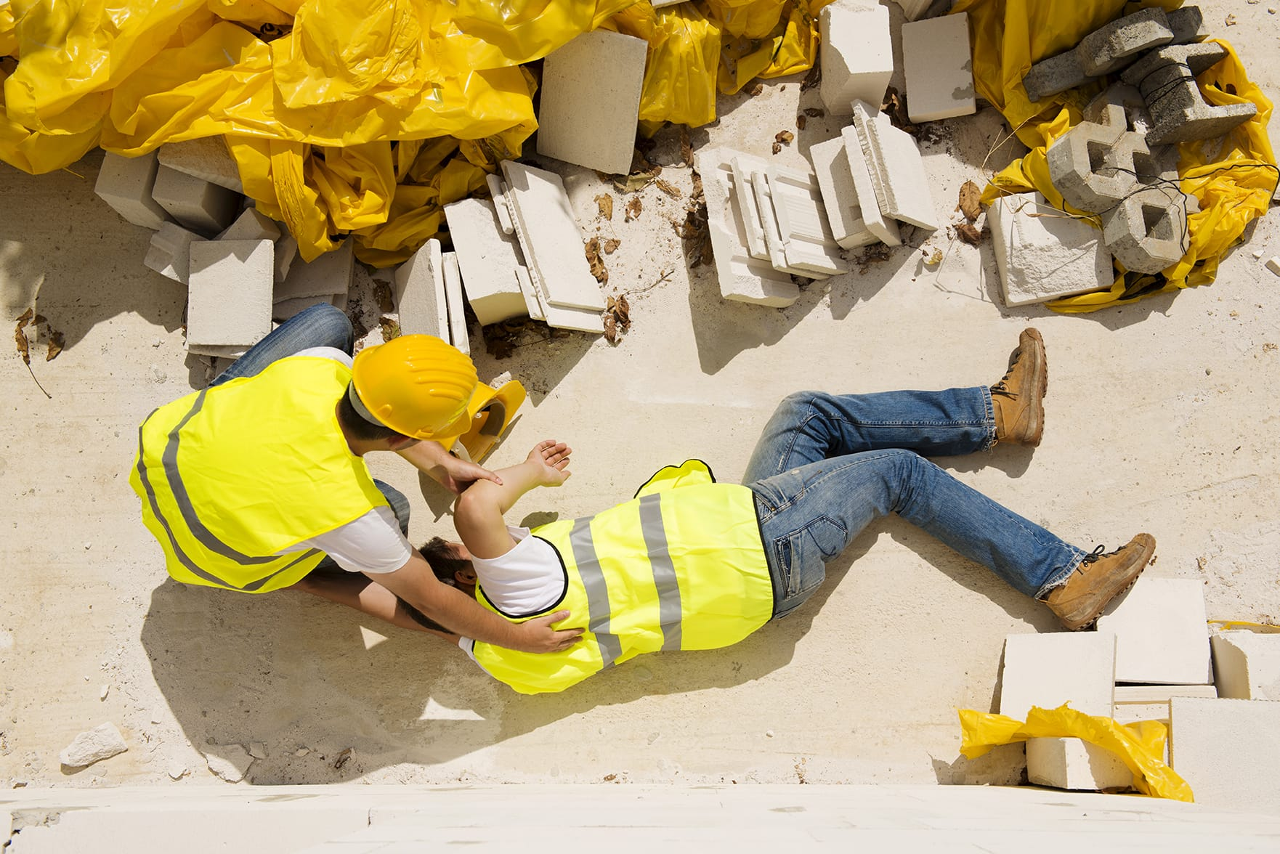
What’s at Stake?
You can slip, trip and fall in offices to construction sites. Falls are the leading cause of injuries in North American workplaces.
Notes:
WHAT'S AT STAKE
You can slip, trip and fall in all kinds of workplaces, from offices to construction sites. Falls are the leading cause of injuries in North American workplaces.
(Next Slide)

Slide 4
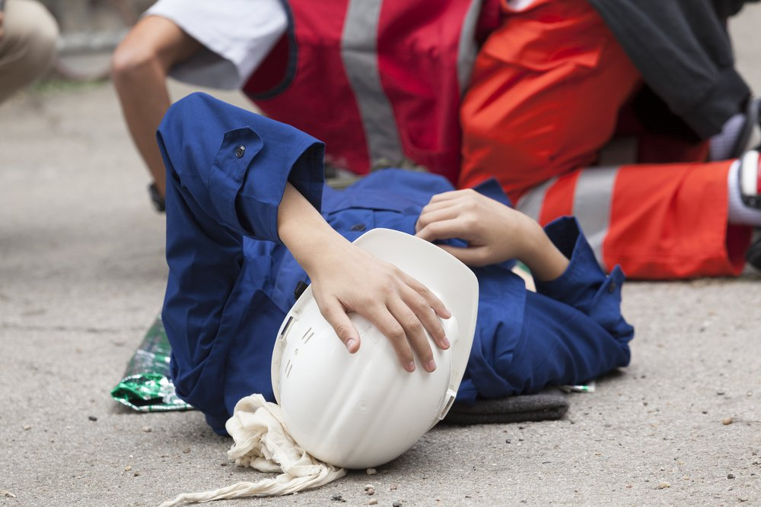
What’s the Danger?
What’s at Stake
Most workplace falls which cause injury or death are falls from the same level, not from heights.
Example…
You may be in a hurry and run down a flight of stairs, or walk a corridor while reading instructions. You might slip on a slick surface and suddenly your feet go out from under you. Falls can also be caused by tripping on an obstacle.
Notes:
WHAT’S THE DANGER
Most workplace falls which cause injury or death are falls from the same level, not from heights. And remember the big picture. Failure to reduce and eliminate slips, trips erodes the bottom line of business and impacts quality of life of workers.
Example
You may be in a hurry and run down a flight of stairs, or walk a corridor while reading instructions. You might slip on a slick surface and suddenly your feet go out from under you. Falls can also be caused by tripping on an obstacle - your feet get caught but your body keeps on going.
(Next Slide)

Slide 5
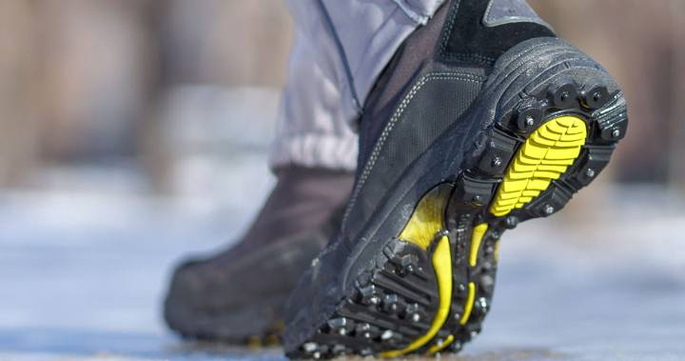
How to Protect Yourself
Wear Appropriate clothing
Wear boots or shoes that have skid-resistant soles and are free from oil and grease. When working on slippery surfaces or in icy weather, wear non-slip soles. Be aware that overly long, loose pant cuffs are a tripping hazard.
Clear paths
If you see something in an aisle such as litter or extension cords, move or report them. Also watch for loose or torn carpeting, mats or runners. Don't store things on or near stairways. Watch out for unexpected hazards such as unguarded floor openings. Report them immediately so they can be correctly covered and guarded.
Notes:
HOW TO PROTECT YOURSELF
Appropriate clothing
Wear boots or shoes that have skid - resistant soles and are free from oil and grease. When working on slippery surfaces or in icy weather, wear non-slip soles. Be aware that overly long, loose pant cuffs are a tripping hazard.
Clear paths
If you see something in an aisle such as litter or extension cords, move or report them. Also watch for loose or torn carpeting, mats or runners. Don't store things on or near stairways. Watch out for unexpected hazards such as unguarded floor openings. Report them immediately so they can be correctly covered and guarded.
(Next Slide)

Slide 6
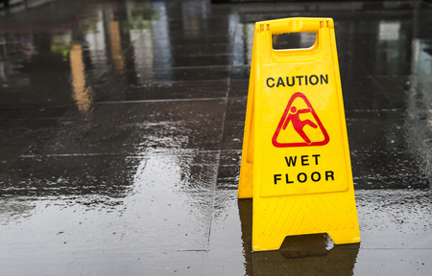
How to Protect Yourself
What’s at Stake
Respect slickness
Obey signs such as "Caution: Wet Floor." Clean up spills immediately. Newly waxed and high gloss floors are also hazarding. On slippery or rough surfaces, take small steps and walk slowly.
Walk safely
Keep your head up. Don't run down a hallway. Never engage in horseplay. Use stairways' handrails. When carrying a load, make sure you can see over or around it. On slick surfaces keep your hands at your side for balance and take caution, short steps. Don’t run.
Notes:
HOW TO PROTECT YOURSELF
Respect slickness
Obey signs such as "Caution: Wet Floor." Clean up spills immediately. When you come indoors from rain or snow, your wet footwear slides more easily. Newly waxed and high gloss floors are also hazarding. On slippery or rough surfaces, take small steps and walk slowly.
Walk safely
Keep your head up. Don't run down a hallway. Never engage in horseplay. Use stairways' handrails. When carrying a load, make sure you can see over or around it. On slick surfaces keep your hands at your side for balance and take caution, short steps. Don’t run.
(Next Slide)

Slide 7
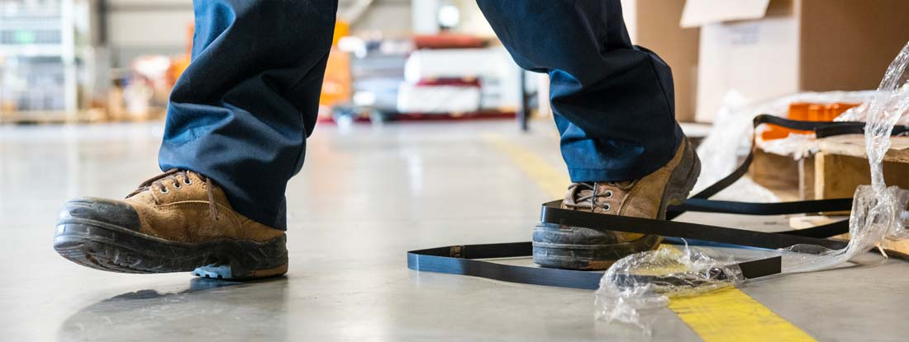
How to Protect Yourself
Office smarts
Don't tip back in a chair. Keep drawers of desks, cupboards and filing cabinets closed.
Elevate wisely
Don't stand on makeshift platforms such as a chair on top of a desk. Instead, correctly use a stepstool, ladder or scaffold.
Working at heights
Be sure to use the required fall protection equipment and all safe procedures when working at heights.
Notes:
HOW TO PROTECT YOURSELF
Office smarts
Don't tip back in a chair. Chairs should have five legs to prevent tipping. Keep drawers of desks, cupboards and filing cabinets closed.
Elevate wisely
Don't stand on makeshift platforms such as a chair on top of a desk. Instead, correctly use a stepstool, ladder or scaffold.
Working at heights
Be sure to use the required fall protection equipment and all safe procedures when working at heights. Many falls from heights are actually caused by tripping or slipping.
(Next Slide)

Slide 8
How to Protect Yourself
What’s at Stake
Shed light
Poor lighting can camouflage hazards, so replace fixtures or bulbs that don’t work. Turn on lights before entering an area.
Practice stair care
There’s always a potential for trips and falls on stairways that are too steep or not steep enough. Always walk up and down stairs slowly, one step at the time. Numerous workers have been injured on stairways by going to fast or by skipping steps. Try to keep one hand free to hold the railing if you are carrying a load.
Personal regimen
Get enough rest and sleep. Exercise regularly. Eat nutritious well-balanced diet and include vitamin C. More alert, physically and mentally fit workers are better equipped to handle safety challenges.
Notes:
HOW TO PROTECT YOURSELF
Shed light
Poor lighting can camouflage hazards, so replace fixtures or bulbs that don’t work. In areas where no fixtures are installed, make sure obstacles have been removed. Turn on lights before entering an area.
Practice stair care
There’s always a potential for trips and falls on stairways that are too steep or not steep enough. Always walk up and down stairs slowly, one step at the time. Sound too caution? Numerous workers have been injured on stairways by going to fast or by skipping steps. And if you must carry a load on stairs, make sure the load doesn’t block your vision, and try to keep one hand free to hold the railing.
Personal regimen
Get enough rest and sleep. Exercise regularly. Eat nutritious well-balanced diet and include vitamin C. More alert, physically and mentally fit workers are better equipped to handle safety challenges like slips, trips and falls in a successful way.
(Next Slide)

Slide 9
How to Protect Yourself
What’s at Stake
Good housekeeping and clean up tips:
Wipe up grease, water and other slick substances as soon as they are discovered. Cover icy and greasy spots with sand, dirt or other absorbent material.
If repair or maintenance work is being done, keep equipment and the surrounding area free of scraps and debris.
Secure lose or light material to prevent it from blowing away in the wind.
Inspect your work area and machinery or tools before you start work.
Notes:
HOW TO PROTECT YOURSELF
Good housekeeping and clean up tips:
Wipe up grease, water and other slick substances as soon as they are discovered. Cover icy and greasy spots with sand, dirt or other absorbent material.
If repair or maintenance work is being done, keep equipment and the surrounding area free of scraps and debris.
Secure lose or light material to prevent it from blowing away in the wind and, as with any other aspect of rig operation, don’t let material fall from any level.
Inspect your work area and machinery or tools before you start work.
(Next Slide)

Slide 10
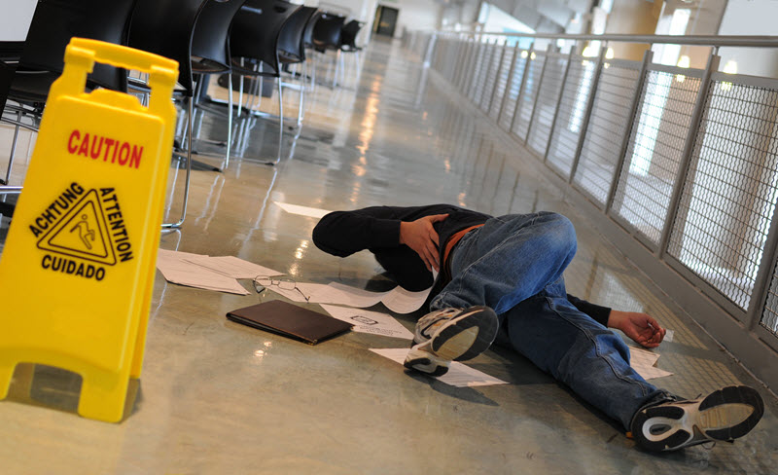
Final Word
Slips, trips and falls are serious hazards.
Follow these steps to keep your feet on firm ground.
Notes:
FINAL WORD
Slips, trips and falls are serious hazards. Follow these steps to keep your feet on firm ground.
(Next Slide)

Slide 11
End of Presentation
Notes:
(Next Slide)

