Slide 1

Click anywhere to get started…

Slide 2
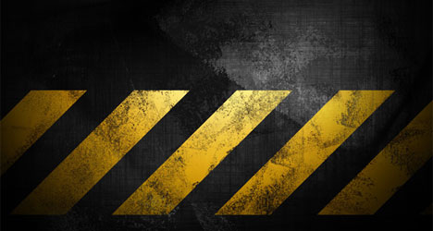
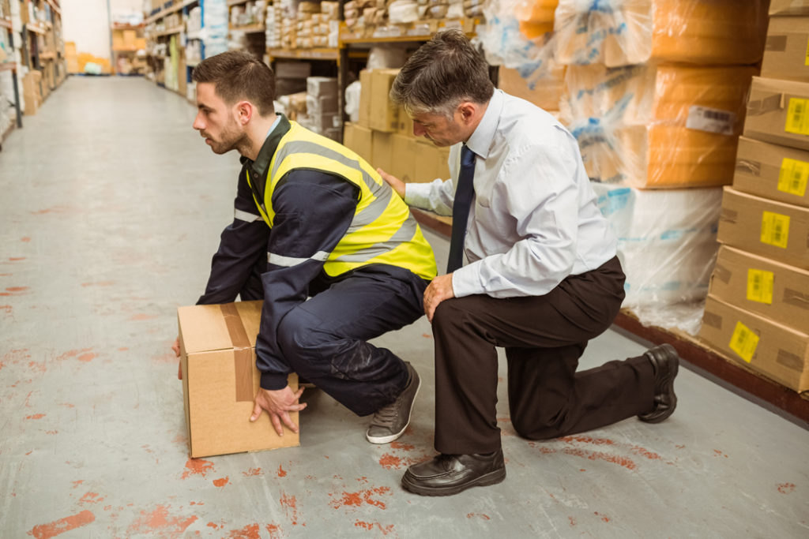

Safe Lifting & Ergonomics
Notes:
Safe Lifting & Ergonomics

Slide 3
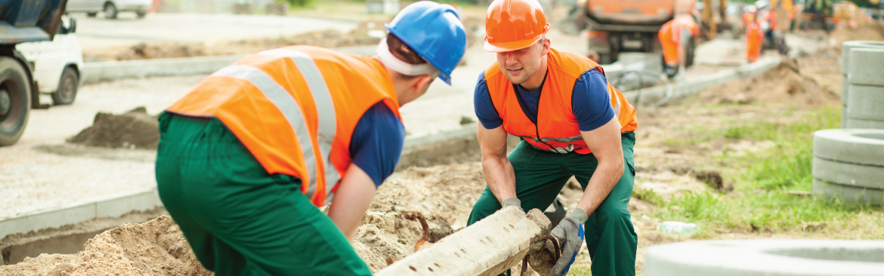
What’s at Stake?
Ergonomics and safe lifting practices go “hand in hand”. The back is an apt starting point in the study of ergonomics. Back injuries are a major cause of lost workdays.
Notes:
What’s at Stake?
Ergonomics and safe lifting practices go “hand in hand”. Ergonomic can be defined as the study of people in their working environment. The back is an apt starting point in the study of ergonomics. Why? Because back injuries are a major cause of lost workdays and represent nearly a quarter of lost time and half of all compensation costs both long – term and short – term.

Slide 4
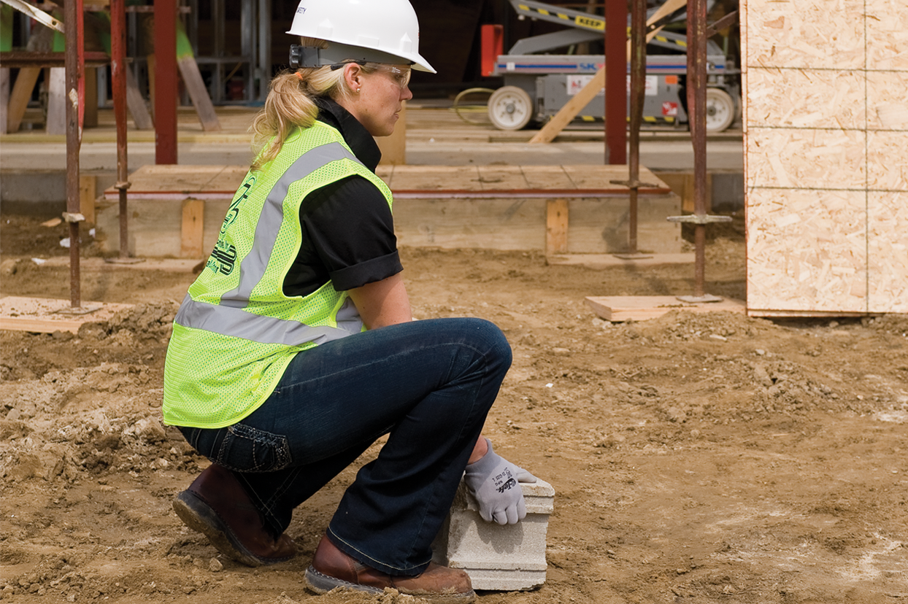
What’s the Danger?
Your back is not a tool. It is a network of fragile ligaments, discs and muscles which can easily be thrown out of order.
There are 33 vertebrae in your back that are separated by discs and held together by ligaments. The back has many different muscles to hold all the vertebrae together. Three curves make up your back – cervical (neck), thoracic (mid-back) and lumbar (lower back)).
Common causes of back pain include but are not limited to sitting improperly, heavy lifting, falls, motor vehicle incidents and whole-body vibration. Every time you bend, your back lifts approximately 70% of your body weight even when you aren’t lifting anything.
Notes:
What’s the Danger?
Your back is not like other tools that you can replace when they are damaged.!!! The back is a network of fragile ligaments, discs and muscles which can easily be thrown out of order.
There are 33 vertebrae in your back that are separated by discs and held together by ligaments. The back has many different muscles to hold all the vertebrae together. Three curves make up your back – cervical (neck), thoracic (mid-back) and lumbar (lower back)). Unless you are standing in a natural position, with your ears, shoulders and hips all aligned, your spine is under some type of stress.
Almost everyone has suffered back pain at some time. Common causes include but are not limited to sitting improperly, heavy lifting, falls, motor vehicle incidents and whole-body vibration. To understand how often the back is used, just think that every time you bend, your back lifts approximately 70% of your body weight even when you aren’t lifting anything.

Slide 5
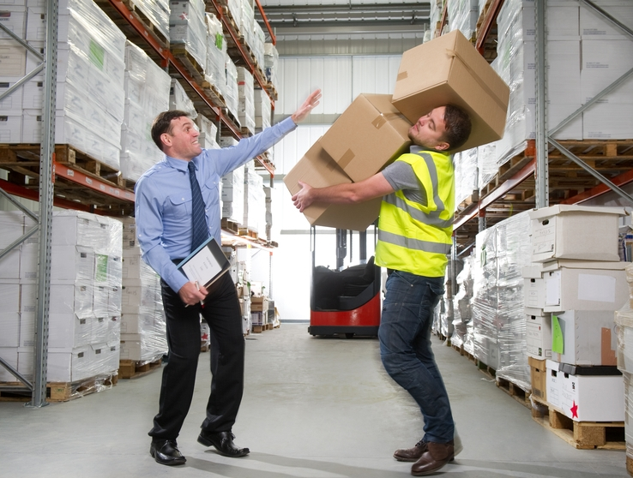
Ergonomic Concerns
It is not necessarily the weight of the load that causes the injuries, but rather the frequency and duration of handling. If the load is heavy, the frequency and duration of the lift will have to decrease.
After sitting or stooping for a long period of time you should not lift immediately, as this puts a great deal of stress on your back muscles, ligaments and tendons.
Overexertion and cumulative trauma were the biggest factors in back injuries. Bending, followed by twisting and turning, were the more commonly cited movements that caused back injuries. Strains and sprains from lifting loads improperly or from carrying loads that are either too large or too heavy.1
What’s the Danger?
Notes:
What’s the Danger?
Ergonomic Concerns
It is important to remember that it is not necessarily the weight of the load that causes the injuries, but rather the frequency and duration of handling. If the load is heavy, the frequency and duration of the lift will have to decrease. The human body is made for a variety of tasks, so it’s important to have variety in the tasks you do to prevent repetitive stress and keep your body active and flexible.
After you have been sitting or stooping for a long period of time you should not lift immediately, as this puts a great deal of stress on your back muscles, ligaments and tendons.
Overexertion and cumulative trauma were the biggest factors in these injuries. Bending, followed by twisting and turning, were the more commonly cited movements that caused back injuries. Strains and sprains from lifting loads improperly or from carrying loads that are either too large or too heavy are common hazards associated with manually moving materials.

Slide 6
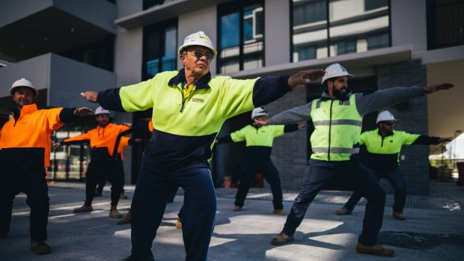
How to Protect Yourself
Pre-lift stretching
When beginning an on-site stretching program, some key points need to be followed:
Keep the stretches simple and make sure they are well designed so that they don’t cause harm to workers.
Workers with existing muscle, ligament or tendon injuries should not perform the stretches without first discussing them with their health care provider.
Remember to instruct workers to breathe when they are stretching.
All workers need to be well instructed on how to perform the stretch properly.
It is best if a leader is appointed (usually part of the management team) to lead the stretches.
There is evidence to show more frequent short stretching breaks (2-3 minutes in length) are better than one long one (10-15 minutes).
Notes:
How to Protect Yourself
Pre-lift stretching
When beginning an on-site stretching program, some key points need to be followed:
Keep the stretches simple and make sure they are well designed so that they don’t cause harm to workers.
Workers with existing muscle, ligament or tendon injuries should not perform the stretches without first discussing them with their health care provider.
Remember to instruct workers to breathe when they are stretching.
All workers need to be well instructed on how to perform the stretch properly.
It is best if a leader is appointed (usually part of the management team) to lead the stretches.
There is evidence to show that more frequent short stretching breaks (2-3 minutes in length) are better than one long one (10-15 minutes).

Slide 7
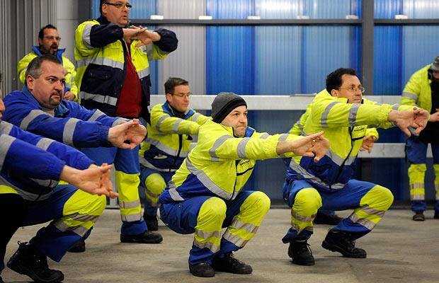
How to Protect Yourself
Some Basic Back Stretches
Sit or stand tall with your back straight (do not arch your back). Make sure your abdominal muscles are tight and tucked in. Interlace your fingers and your arms over your head, keeping the elbows straight. Extend your arms as far back as you can. To stretch your sides, slowly lean to the left and then to the right.
Middle & upper back stretch
Extend your left arm in front of your body. Place your right hand underneath your left elbow and pull toward your body. Keep the left arm extended.
Standing back bends
Place your hands in the small of your back and slowly bend backwards until you feel a gentle stretch in your trunk. Remember that stretching should not cause any pain.
Notes:
How to Protect Yourself
Some Basic Back Stretches
Upper back & side stretch
Sit or stand tall with your back straight (do not arch your back). Make sure your abdominal muscles are tight and tucked in. Interlace your fingers and your arms over your head, keeping the elbows straight. Extend your arms as far back as you can. To stretch your sides, slowly lean to the left and then to the right.
Middle & upper back stretch
Extend your left arm in front of your body. Place your right hand underneath your left elbow and pull toward your body. Keep the left arm extended.
Standing back bends
Place your hands in the small of your back and slowly bend backwards until you feel a gentle stretch in your trunk. Remember that stretching should not cause any pain.

Slide 8
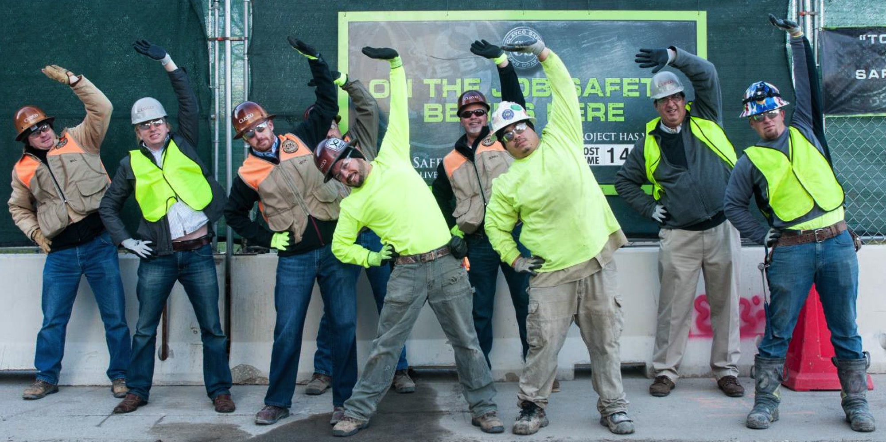
How to Protect Yourself
Middle back stretch
Stand with your hands on your hips, keeping a slight bend in your knees. Gently twist your torso at the waist until the stretch is felt.
Hamstrings stretch
Stand behind a chair, hold the back of it with both hands, or place both hands on the front of wall. Bend forward from the hips, keeping the back straight at all times – do not make a ‘hump’ with any part of your back or shoulders at any time. When the upper body is parallel to floor, hold this position.
Set up and maintain a regular exercise program, with some emphasis on back and abdominal strengthening and stabilization.
Notes:
How to Protect Yourself
Middle back stretch
Stand with your hands on your hips, keeping a slight bend in your knees. Gently twist your torso at the waist until the stretch is felt.
Hamstrings stretch
Stand behind a chair, hold the back of it with both hands, or place both hands on the front of wall. Bend forward from the hips, keeping the back straight at all times – do not make a ‘hump’ with any part of your back or shoulders at any time. When the upper body is parallel to floor, hold this position.
If you don’t set up and maintain a regular exercise program, with some emphasis on back and abdominal strengthening and stabilization, the wear and tear can worsen and cause back problems even earlier.
Workers are much less likely to suffer an injury if they have been trained to recognize high-risk tasks and have the knowledge necessary to modify the task or ask for the task to be modified. This is why a Musculoskeletal Disorder Prevention Program (Ergonomic Program) is so important.

Slide 9
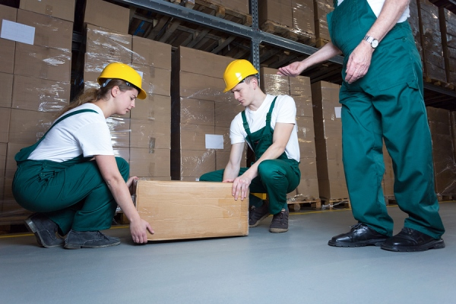
How to Protect Yourself
The lift starts:
Start by assessing the shape and size of the load. If you think you will be unable to lift it on your own, ask for help.
Make sure the load is free or loose and able to be moved.
Check the travel route to make sure it’s free of obstacles, debris and any slip or trip hazards.
Keep the load close to your body.
Do not twist while handling the load, as this will place extreme strain on your back.
Notes:
How to Protect Yourself
The lift starts:
Start by assessing the shape and size of the load. If you think you will be unable to lift it on your own, ask for help.
Make sure the load is free or loose and able to be moved.
Check the travel route to make sure it’s free of obstacles, debris and any slip or trip hazards.
Keep the load close to your body.
Do not twist while handling the load, as this will place extreme strain on your back.

Slide 10
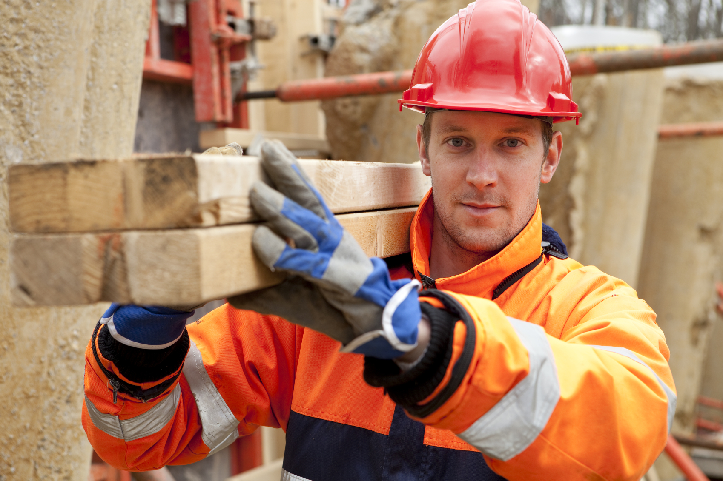
How to Protect Yourself
Make sure you have firm footing, a wide stance, good grip and keep your arms straight.
Bend your knees as much as possible. If the load is large, you may have to stand slightly over it to start the lift.
Tighten your abdominal muscles and try to tuck your chin into your chest.
Initiate the lift with your body weight and lift with your legs, as they are a larger and stronger muscle group.
If you are unable to use a smooth and slow lifting approach, use momentum to help bring the load closer to your body.
Notes:
How to Protect Yourself
Make sure you have firm footing, a wide stance, good grip and keep your arms straight.
Bend your knees as much as possible. If the load is large, you may have to stand slightly over it to start the lift.
Tighten your abdominal muscles and try to tuck your chin into your chest.
Initiate the lift with your body weight and lift with your legs, as they are a larger and stronger muscle group.
If you are unable to use a smooth and slow lifting approach, use momentum to help bring the load closer to your body.

Slide 11
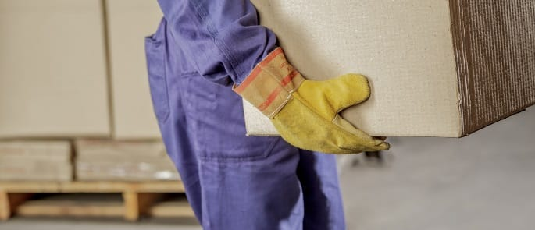
Final Word
Your back is not a “tool” that you can easily replace. If you injure your back, it could have lifelong negative consequences for you at work and in your non-work life.
Treat your back with kindness and intelligence.
Notes:
Final Word
Your back is not a “tool” that you can easily replace. If you injury your back, it could have lifelong negative consequences for you at work and in your non- work life. Treat your back with kindness and intelligence.

