Slide 1



Powered Industrial Truck (PIT) Forklift Safety
Operator Training Course

Slide 2

Instructor Name
Organization Name

Slide 3
Key Learning Objectives
OSHA PIT Regulatory Requirements
Forklift PIT Statistics
PIT Classifications
Forklift PIT Inspections
Refueling and Recharging
Safe Operating Practices
Loading and Unloading Practices
Stability Triangle
Load Safety Practices
Reading Capacity Plates
Calculating Maximum Load Capacity
Pedestrian Safety Practices
Forklift Attachment Safety
Watch Forklift Safety Video
Practical Skills Evaluation

Slide 4
Powered Industrial Truck Defined
According to OSHA standard 1910.178, a powered industrial truck is defined as a fork truck, tractor, platform lift truck, motorized hand truck, and other specialized industrial trucks powered by electric motors or internal combustion engines.
Notes:
Part 1910 Occupational Safety and Health Standards (General Industry)
Subpart N – Materials Handling and Storage
Section 1910.178

Slide 5
Powered Industrial Truck Defined
Commonly called forklifts
Carry and move materials
May be powered by electric or combustion engines
Includes:
Rider pallet trucks
Narrow aisle lift trucks
Telehandler forklifts
Does not include:
Earth moving
Over-the-road hauling
Bobcat or skid steer
Scissor lifts and aerial lifts

Slide 6
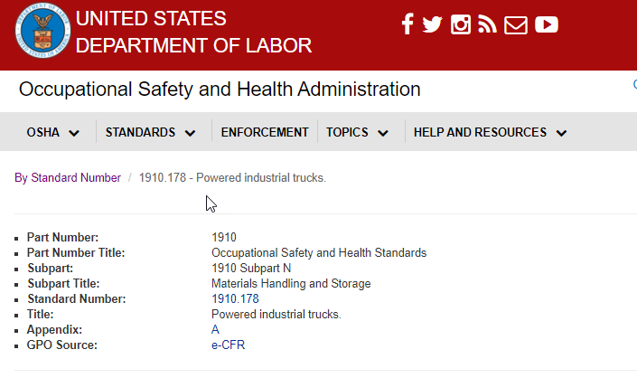
FED OSHA 1910.178 Powered Industrial Trucks
Review Fed OSHA 1910.178 standard at:
https://www.osha.gov/laws-regs/regulations/standardnumber/1910/1910.178
Notes:
Forklift Powered Industrial Truck standard 1910.178

Slide 7
OSHA Forklift PIT Operator Requirements
Only trained and authorized operators permitted to operate a forklift PIT.
Must complete a safety training and evaluation on specific forklift PIT.
Must operate forklift PIT in a safe manner consistent with their training.
Must inspect forklift PIT at the beginning of each work shift.
Must report all forklift maintenance needs to the immediate supervisor.
Must comply with all OSHA regulations while operating a forklift PIT.

Slide 8
OSHA Employer Training Requirements
Ensure operator competency
Certify operators trained and evaluated
  Based on OSHA Standard 1910.178
Certification must include:
  Name of operator
  Date of safety training
  Date of operator evaluation
  Name and signature of person(s) conducting the training and evaluation

Slide 9
OSHA Employer Training Requirements
What does certification mean?
Employer is certifying that each operator…
Has received required safety training
Has been evaluated
Has demonstrated competency

Slide 10
OSHA Employer Training Requirements
Evaluate operators every 3 years
Refresher training needed if …
  Operator is operating PIT unsafely
  Accident or near-miss incident occurs
  Operator is assigned different type of PIT
  Changes in the workplace
  Operator fails an evaluation
Notes:
Operators will receive a documented evaluation every 3 years
Operators will receive refresher training if any of the above listed is observed

Slide 11
OSHA Training Requirements
Why is specific forklift safety training required?
Different work conditions and environments
PITs have unique characteristics
Each PIT has different hazards
Modified or use attachments

Slide 12
OSHA Training Requirements
Who is required to comply?
Employers with forklift operators
Employers with pedestrians
General contractors
Vendors and visitors

Slide 13
OSHA Training Requirements
Who must be trained?
Powered industrial truck operators?
New hires with prior certification?
Occasional operator?
Owner of business?

Slide 14
What Subjects Must Be Covered?
Forklift Specific Related Topics
All operating instructions
Similarities and differences to automobile
Controls and instrumentation
Steering and maneuvering
Visibility (including restrictions due to loading)
Fork and attachment adaptation
Forklift capacity
Forklift stability
Forklift inspection and maintenance
Refueling or charging, recharging batteries
Operating limitations; and….
Any other operating instructions

Slide 15
What Subjects Must Be Covered?
Workplace Specific Related Topics
Surface conditions
Composition of probable loads
Load stability
Load manipulation, stacking and unstacking
Pedestrian traffic
Narrow aisles and other restricted places of operation
Operating in hazardous locations
Operating the truck on ramps and sloped surfaces
Operating the vehicle in closed or poorly ventilated areas; and….
Other unique or potentially hazardous environmental conditions that exist or may exist in the workplace

Slide 16
Quiz
Who is permitted to operate a forklift PIT for our company?
What is the OSHA standard # that regulates safe use of powered industrial trucks?
What is OSHA referring to when they require workplace specific training?
Notes:
Only trained and authorized operators
OSHA Standard 1910.178
Forklift PIT training must be specific to the workplace environment where the forklift is being operated.

Slide 17
PIT Statistics
On average, 1 fatality every 3 days
95,000 non-fatal injuries every year
25% of all accidents are due to rollovers
36% of related deaths are pedestrians
70% of accidents could be prevented
36% of fatalities are pedestrians
Sources: Bureau of Labor Statistics & OSHA

Slide 18
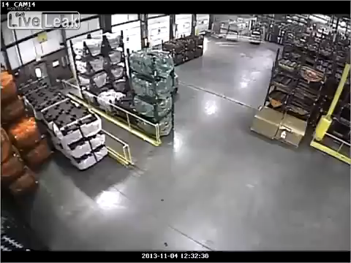
Forklift Accident Video
Notes:
Click on the image to view the video
This I short video of a powered industrial truck forklift accident that was caught on camera. This was a seasoned operator who had gone through the OSHA required PIT training and yet this accident still occurred. Lets take a look: Oh by the way there is no sound to this video – You will want to focus towards the upper middle of the video to see what happens.
In the video we see a pedestrian walking towards the path of a powered industrial truck when he is suddenly distracted by something. He doesn't see the PIT coming towards him until it was too late. The operator on the other hand was moving forward with a restricted view and he didn’t see the pedestrian. Tragically it was a perfect storm that resulted in this horrible accident.
This is why it’s so important to understand the hazards, risks and OSHA requirements associated with operating powered industrial trucks.
Could a similar accident happen in our operations? The answer to that for most of us on this call is yes.
If an OSHA inspector viewed this video, who would they have blamed? The operator, pedestrian or employer? 9 times out of 10 OSHA would have blamed and cited the employer.
Could this accident have been prevented? Absolutely 100%

Slide 19
Breakout Activity – Forklift Hazard Identification
Using the video we just viewed. Please list all of the hazards you observed.
Next, please list safety practices or controls that you would implement to prevent this type of forklift accident.
Notes:
If possible, create two or three break groups of operators to complete this activity
If you don’t have a sufficient number of operators for breakout groups, then review this activity with a single group.

Slide 20
Powered Industrial Truck Classifications
Class I — Electric Motor Rider Trucks (Cushion or Pneumatic)
Class II — Electric Motor Narrow Aisle Trucks
Class III — Electric Motor Hand Trucks or Hand/Rider Trucks
Class IV — Internal Combustion Engine Trucks (Cushion Tires)
Class V — Internal Combustion Engine Trucks (Pneumatic Tires)
Class VI — Electric and Internal Combustion Engine Tractors
Class VII — Rough Terrain Forklift Trucks
Notes:
Powered industrial trucks are classified by manufacturers according to their individual characteristics. Classification depends on factors such as application use, fuel options and features of the lift. This is important because OSHA requires the employer to certify that their operators are knowledgeable and competent to use each class of lift they will be operating.
There are seven classes of powered industrial trucks which includes:
Class I— Electric Motor Rider Trucks (Cushion or Pneumatic)
Class I covers all of our electric sit-down lifts. This class of lift is also used where air quality needs to be considered such as cold storage, truck trailers or shipping containers.
Class II— Electric Motor Narrow Aisle Trucks
Class II covers all of our order pickers and reach trucks. They are powered by batteries and are designed for narrow aisle applications such as warehouses that have storage rack set ups.
Class III— Electric Motor Hand Truck or Hand/Rider Trucks
Class III covers all of our electric pallet jacks which includes walk behind or type you ride on. These are powered by batteries and are hand-controlled lifts where the operator controls the lift through a tiller or lever to steer.
Class IV— Internal Combustion Engine Truck (Cushion Tires)
Class IV covers sit-down counterbalanced lifts with cushion tires. They are powered by internal combustion engines that run on either diesel fuel, liquid petroleum gas, gasoline or compressed natural gas. They are generally used in doors, on smooth dry floors and in well ventilated areas.
Class V— Internal Combustion Engine Trucks (Pneumatic Tires)
Covers sit down counterbalanced lifts with pneumatic tires. They run on liquid petroleum gas, gasoline, diesel and compressed natural gas. They are designed primarily for outdoor use.
Class VI— Electric and Internal Combustion Engine Tractors
This class includes electric and internal combustion engine tow tractors. This equipment is most commonly used for towing loads rather than lifting. Trucks in this class are ideal for use at airports but are also commonly used in assembly line areas.
Class VII— Rough Terrain Forklift Trucks
Lifts in this class feature, large, tractor-style tires and are powered almost exclusively by diesel engines for outdoor use in rugged terrain.

Slide 21
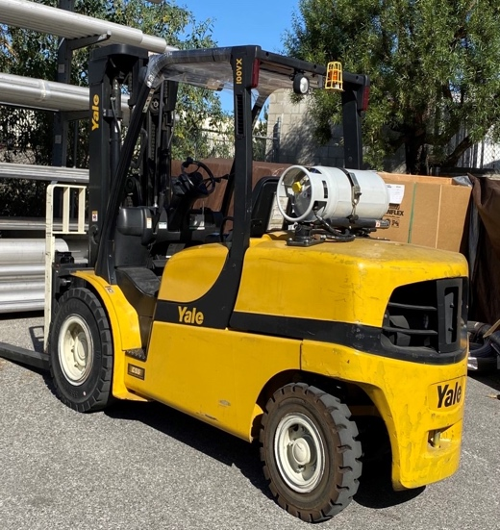
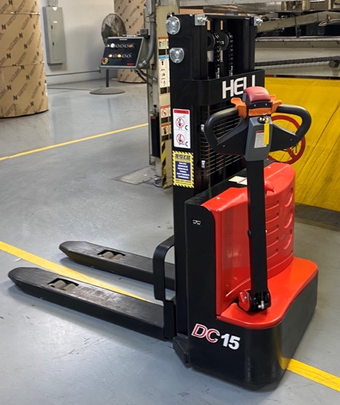
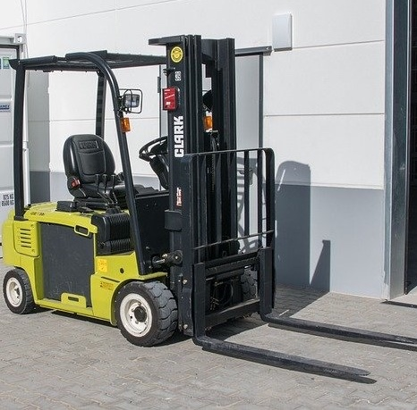
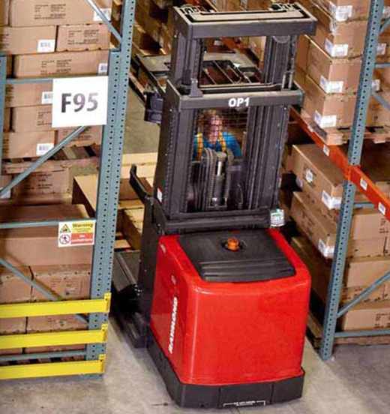
Common PITs Covered Under 1910.178
Propane Powered Forklift - Pneumatic Tires (Class V)
Electric Pallet Jacks
(Class III)
Electric Powered Forklifts (Class I)
Narrow Aisle Lifts – Order
Pickers (Class II)
Notes:
Here are examples of some of the more common powered industrial trucks used in our operations today and the PIT classification.

Slide 22
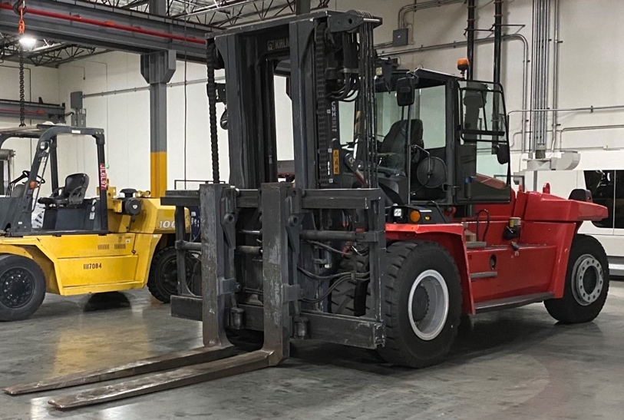
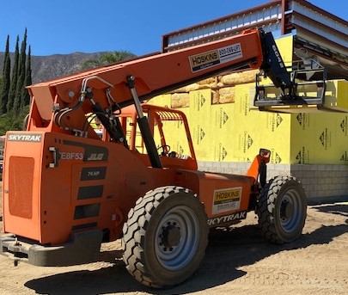
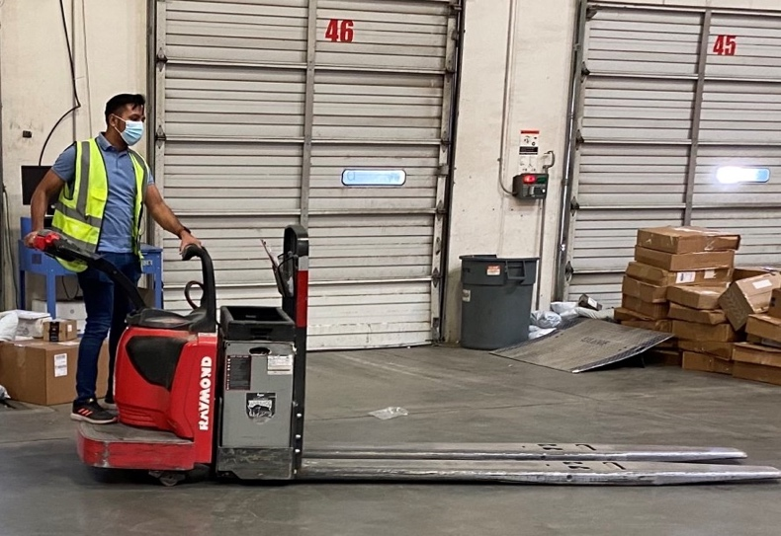
Common PITs Covered Under 1910.178
Diesel Powered Forklift (Class V)
Rough Terrain Forklift (Class VII)
Electric Rider Pallet Jack (Class III)
Notes:
Here are a few more examples

Slide 23
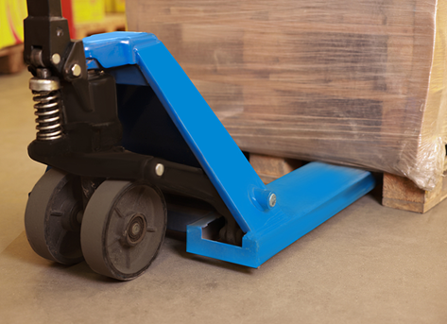
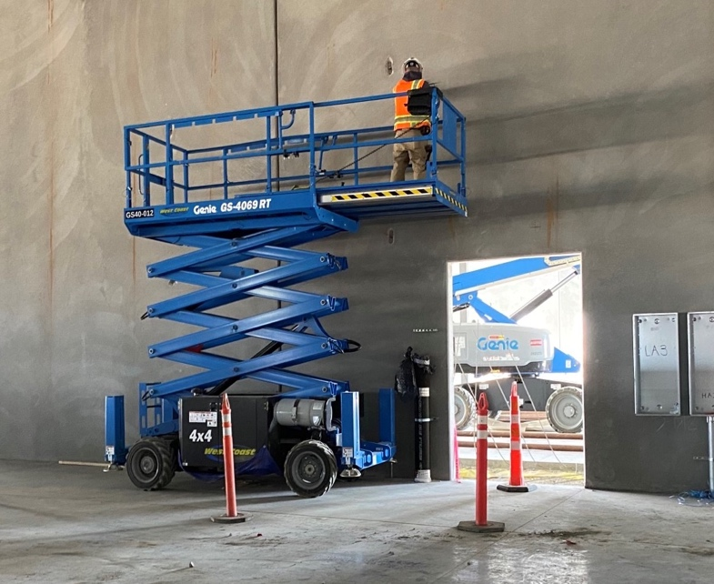
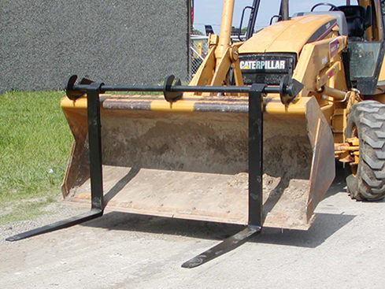
Are These Covered Under 1910.178?
Pallet Jack
Scissor Lift
Front Loader – With Over the Bucket Forks
Notes:
Would operators using this type of equipment be required to go through a training program as outlined in OSHA’s PIT standard 1910.178?
Remember that OSHA defines PITs as specialized industrial trucks powered by electric motors or internal combustion engines. PITs are any mobile, power-propelled truck used to carry, push, pull, lift, stack, or tier materials, whether ridden by the operator or controlled by a walking operator.
So the first picture is of a manual pallet jack – it’s not motorized so therefore not covered under the standard.
The second picture is of a scissor lift and although motorized it’s designed to elevate and carry people not materials. So not covered.
The third picture is a little trickier – it’s a front loader that has been modified with forks. OSHA states that even if the equipment has been modified to accept forks, because it was originally designed as earth moving equipment, it is not covered under1910.178
Does that mean we don’t have to provide safety training for employees that operate this type of equipment? No….we still have to provide safety training, just not as required under the PIT standard.

Slide 24
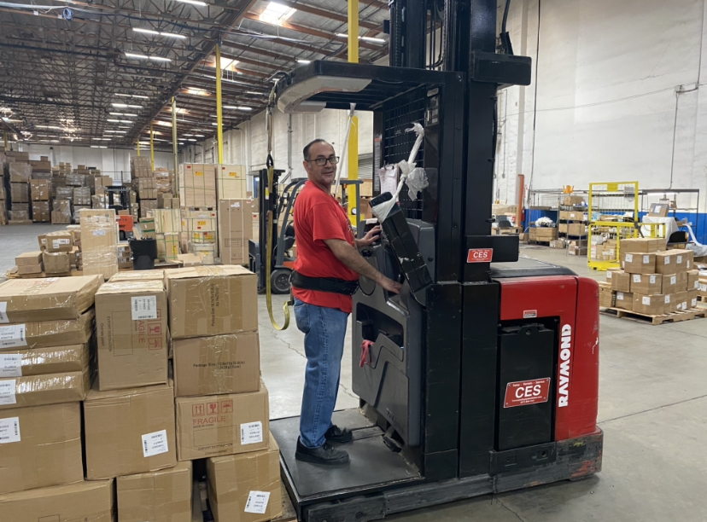
What’s wrong with this picture?
Narrow Aisle Lifts - Order Pickers (Class II)
Notes:
Operator must use a full body safety harness. In the picture he is using a positioning belt which could come off or result in a serious back injury should he fall.

Slide 25
Considerations for Forklift Types/Classes
The weight and size of the load:
Select a forklift with a sufficient capacity.
Identify any attachments needed. Manufacturer approved.
The terrain:
Use solid tires only on smooth indoor surfaces.
Use pneumatic tires for outdoor surfaces.
The environment:
Do not use internal combustion engines in environments with poor ventilation.
Use specially-rated forklifts in combustible or flammable environments.
Notes:
When choosing a particular class and type of forklift PIT be sure to consider:
The weight and side of the load to be lifted
The terrain
The environment

Slide 26
Quiz
What class are narrow aisle order pickers part of?
Why is it important that forklift operators understand classes of forklifts?
What considerations should be taken for the type/classes of lifts that should be used?
Notes:
Narrow aisle order pickers – class II
OSHA requires that operators are knowledgeable and competent to use each class of lift they will be operating and the different safety features, limitations and capabilities of that specific lift.
Weight and size of the load, the terrain, the environment

Slide 27
PIT Inspection Requirements
OSHA standard 1910.178(q)(7) requires that powered industrial trucks shall be examined before being placed in service and shall not be placed in service if the examination shows any condition adversely affecting the safety of the vehicle. Such examination shall be made at least daily. Where industrial trucks are used on a round-the-clock basis, they shall be examined after each shift. Defects when found shall be immediately reported and corrected.
OSHA STANDARD
1910.178 (Q)(7)

Slide 28
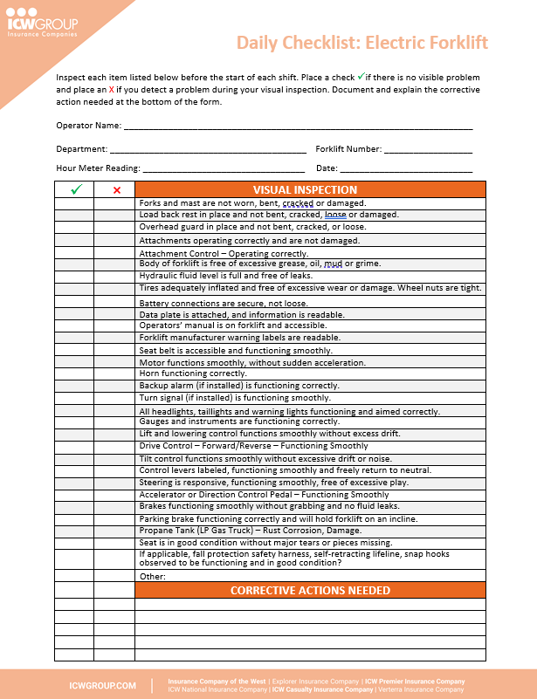
Pre-Shift inspections:
Conduct pre-shift inspections, prior to using the equipment.
Never operate a forklift that needs repair.
Document all corrective action items and maintenance work.
Immediately report maintenance issues to your supervisor or designated maintenance person.

Slide 29
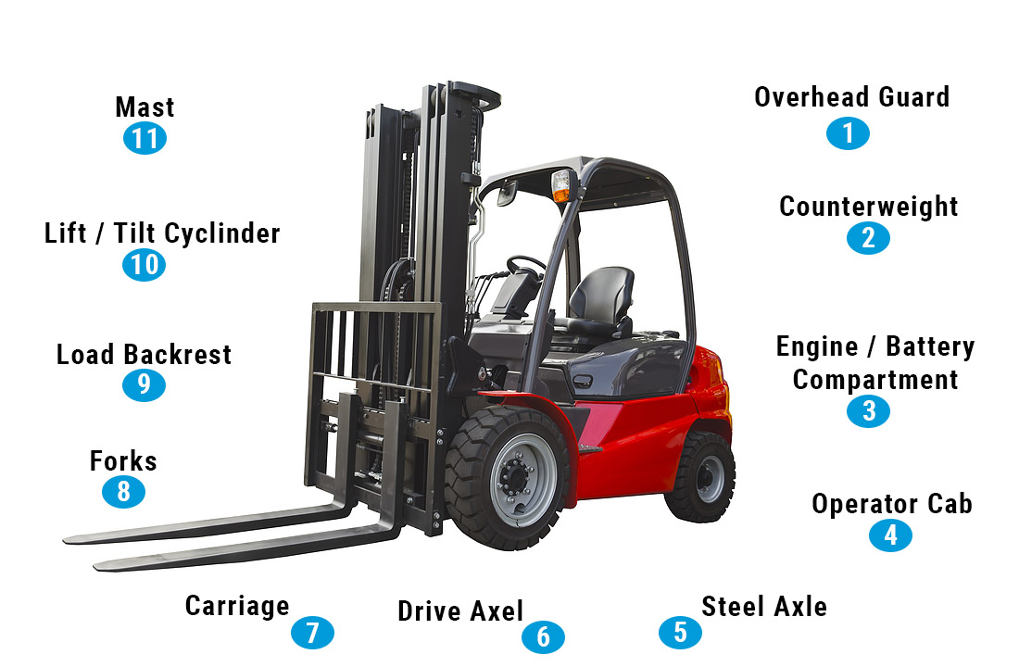
Common Forklift Components
Drive Axle
Steer Axle

Slide 30
Visual Inspections
Look for obvious problems.
Check for hydraulic leaks.
Note any malfunctioning or missing parts.
Examine the hoses and fittings for damage or leaks.
Check the chains for kinks, breaks, or lack of lubrication.
Assure that the overhead guard, mast, and backrest are all undamaged.
Examine any other attachments.

Slide 31
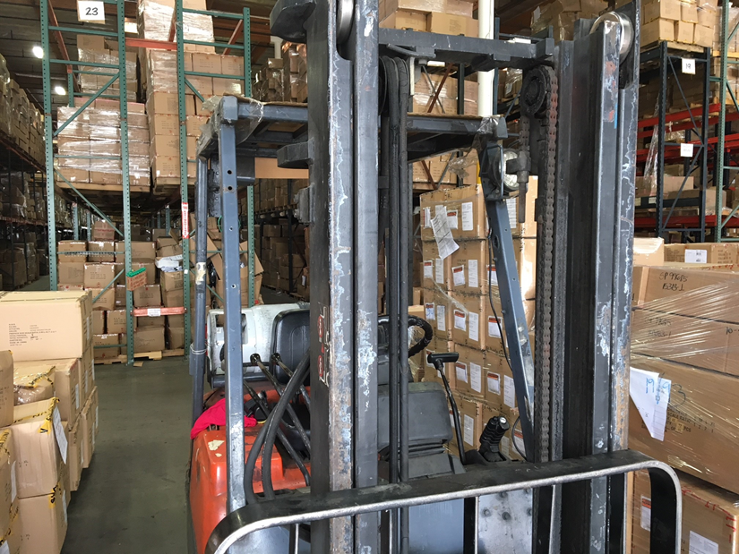
What’s wrong with this picture?

Slide 32
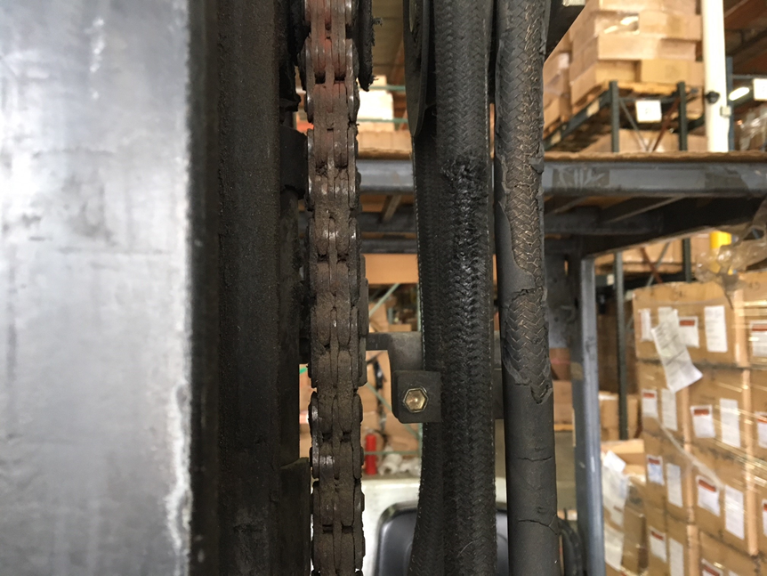
What’s wrong with this picture?

Slide 33
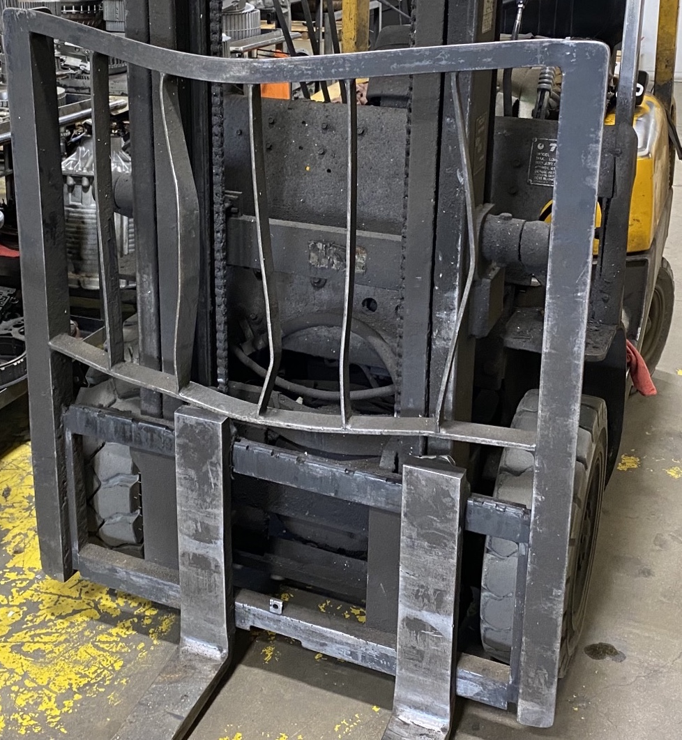
What’s wrong with this picture?

Slide 34
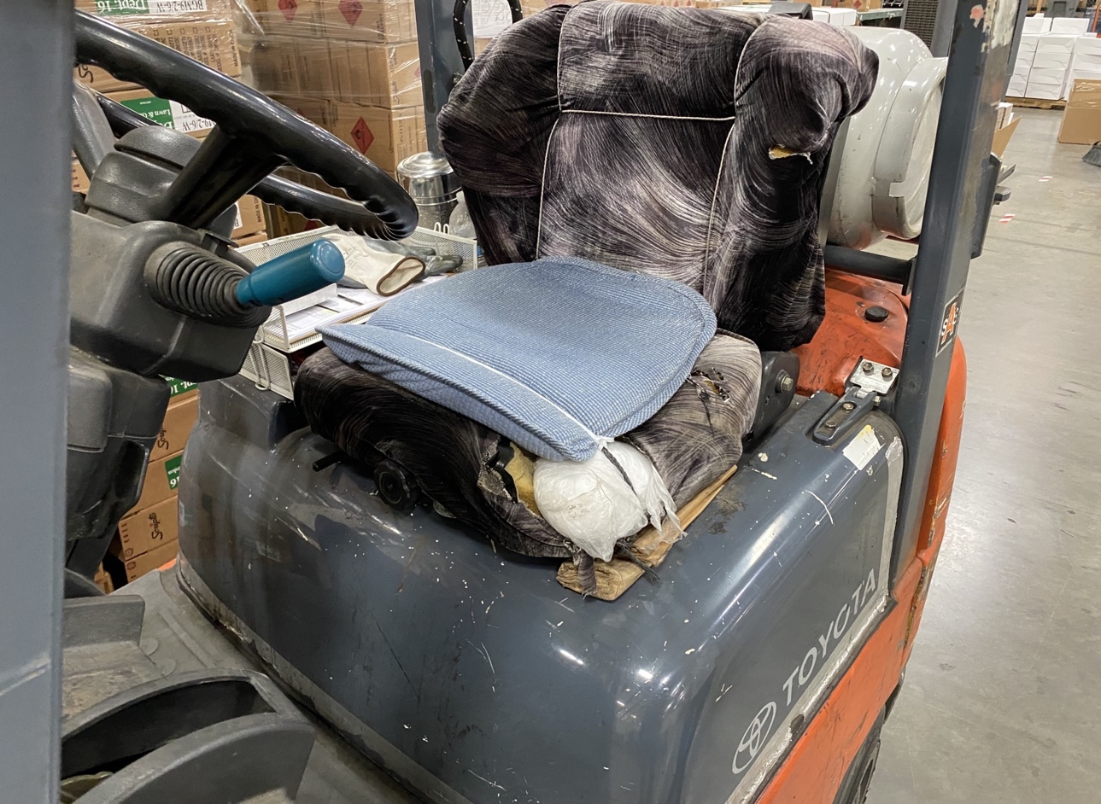
What’s wrong with this picture?

Slide 35
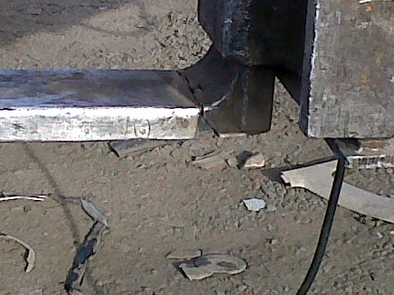
What’s wrong with this picture?
Notes:
The heel is a common area where damage such as surface cracks can occur

Slide 36
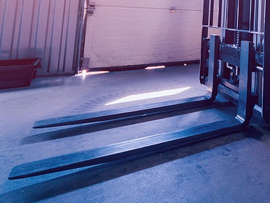
Fork Wear and Damage
Load Backrest
Thin blades
Surface cracks
Bent blades
Damaged backrest
Locking pins
Bent load backrest
Locking Pins
Shank
Heel
Blade
Tip
Notes:
The heel is a common area where damage such as surface cracks can occur
Look for bent or thin blades
Look for damaged or bent load backrest
Make sure that locking pins are not damaged or missing

Slide 37
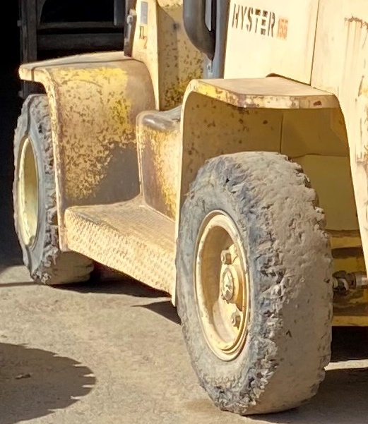
Tire Inspection
Wear
Cracks
Pressure

Slide 38

Forklift Safety Devices
Seatbelts
Lights
Mirrors
Fire extinguishers
Horns
Back up alarms

Slide 39
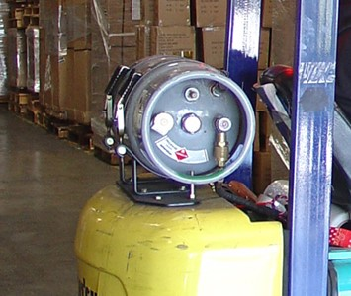
Forklift Safety Devices
Fuel-tank pin
Fuel tank straps
Fuel tank straps
Fuel tank pin
Notes:
Put the tank on the locating pin. The locating pin on the forklifts tank bracket serves four purposes:
it positions the tank properly for the hose and fitting alignment to connect without twisting or stretching the hose;
ensures the pressure relief valve won’t spray LP fuel;
aligns the main valve pick-up tube inside the tank to get almost all the fuel out of the bottom;
and allows the fuel gauge to read correctly.

Slide 40
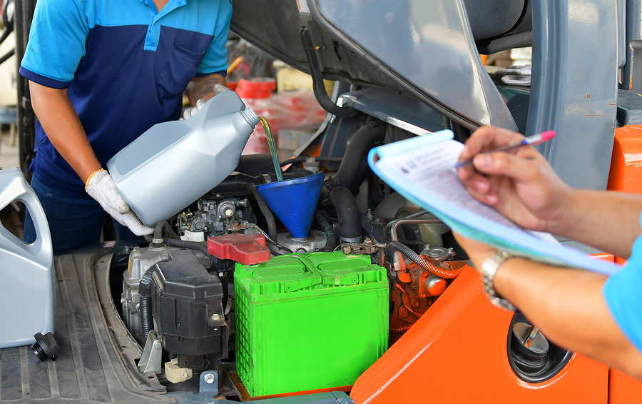

Fluid Levels
Coolant
Battery fluid
Fuel
Hydraulic fluid
Transmission fluid
Oil
Top-off or change low or dirty fluids according to the manufacturer’s instructions.
Notes:
If you are trained and authorized check all fluid levels
If not trained to perform this type of inspection, make sure that your forklift is getting the manufactured required service and inspection

Slide 41
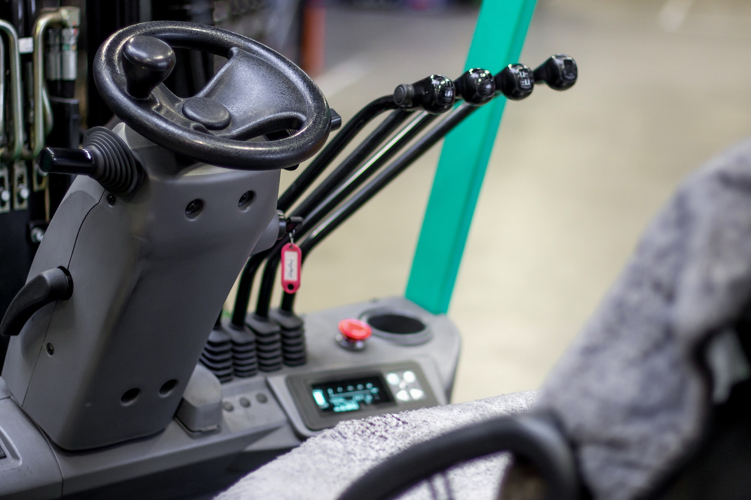
Operational Controls
Review the location of the operational pedals.
Confirm that all controls work.
Determine if the steering is properly responsive.
Test the brakes.

Slide 42
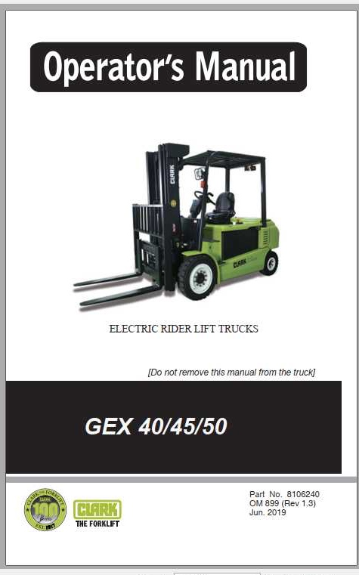
Operator Owner’s Manual
Provides forklift features, functionality, safety and maintenance requirements
Be familiar with manual and reference important safety requirements
Must be legible and readily available
Keep copy of manual on forklift

Slide 43
Quiz
Do all forklift PIT inspections need to be documented?
How often does OSHA require operators to inspect their forklifts?
Too much or too little play on a steering wheel can cause what type of problems?
Notes:
OSHA does not state that all forklift PIT inspections must be documented. The OSHA standard only requires us to conduct the inspection. However, we should be documenting any corrective maintenance items and submitting the completed inspection form to a supervisor or maintenance personnel.
OSHA requires daily inspections if operating the forklift within one shift. If operating multiple shifts, then the inspection should be conducted after each shift.
Too much or too little play on the steering wheel can make it difficult to control and turn the forklift.

Slide 44
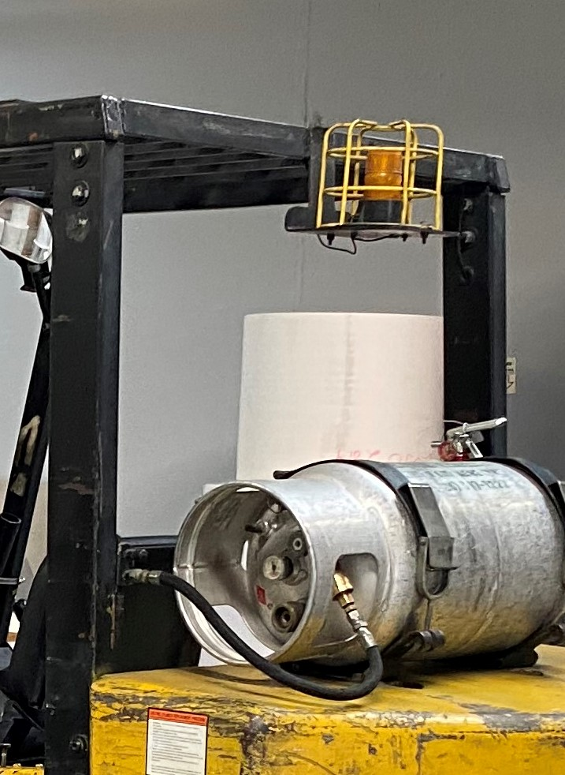
Refueling
Turn off the engine.
Wear appropriate PPE.
Wear protective gloves. Contact with liquid propane can cause freeze burn.
Be sure there is a fire extinguisher and eyewash station.
Never smoke.
Check for leaks before restarting the engine.
Refuel outdoors.

Slide 45
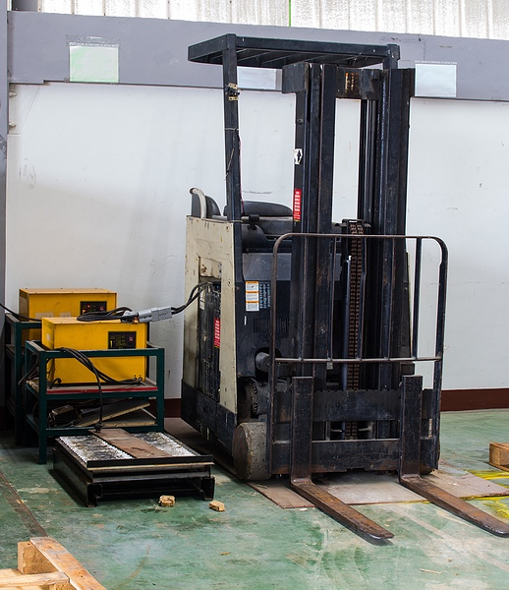
Charging Area Requirements
Adequate ventilation
Charging apparatus with ground connection
Eyewash and safety shower – 15 min continuous flow
Fire extinguisher
Neutralizing materials
No smoking or sparks

Slide 46
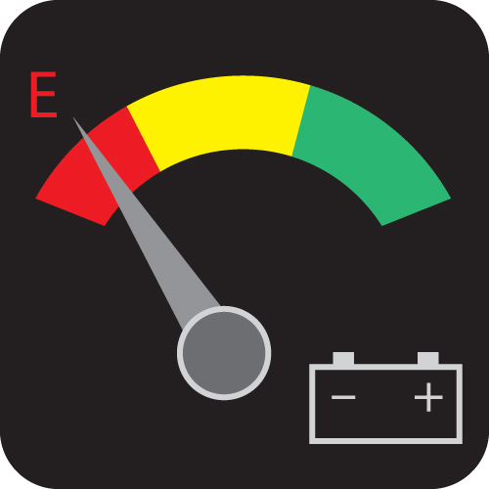
Charging Safe Practices
Turn off the forklift.
Wear PPE.
Keep metal tools and jewelry away.
Check vent caps.
Open covers.
Pour acid into water, never water into acid.
Reinstall batteries securely.
Training must be conducted.
Battery
Notes:
The reason why it is necessary to add acid into water, and not vice-versa, is that otherwise safety hazards such as smoking and splashing can result. This splashing is obviously harmful, as sulfuric acid can ruin one’s clothing and result in burning to the eyes and skin. In order to avoid any splashing, it is also important to pour very slowly.
The importance of adding acid to water is that without acid, water is unable to maintain an electric charge.

Slide 47
Quiz
Why is it important to put on gloves when refueling liquid propane forklifts?
How many minutes of continuous flow must an eyewash provide?
Who should receive training on refueling or charging tasks?
Notes:
When refueling liquid propane forklifts, contact with liquid propane can cause freeze burn.
Must provide 15 minutes of continuous flow
If the operator will be responsible for refueling or charging tasks, then they should receive training. Otherwise, maintenance employees or other maintenance employees responsible for this task.

Slide 48
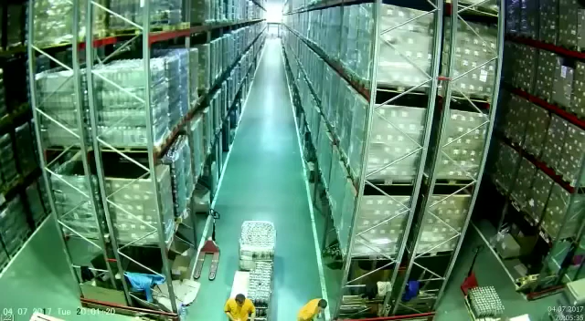
Forklift Accident Video
Notes:
Click on the image to view the video

Slide 49
Breakout Activity – Forklift Hazard Assessment
Please identify 3 common forklift PIT hazards associated with your workplace environment.
Next develop at least one risk/safety control for each hazard that was identified.
Notes:
If possible, create two or three break groups of operators to complete this activity
If you don’t have a sufficient number of operators for breakout groups, then review this activity with a single group.

Slide 50
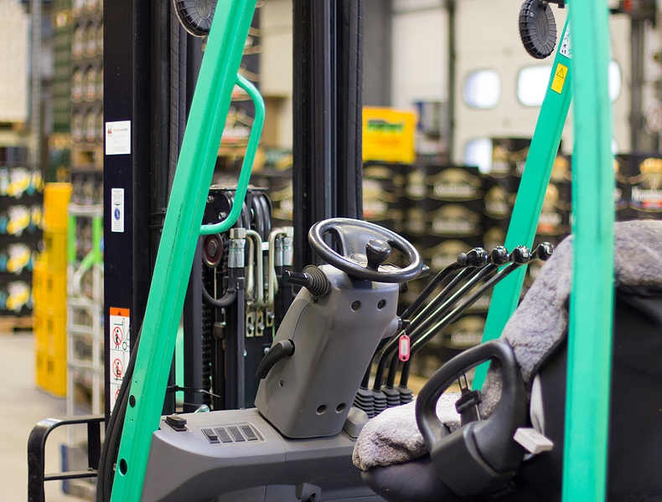
Safe Operating Practices
Prior to Operating:
Plan your route of travel.
Identify narrow aisles and take extra precautions.
Prepare your set-point.

Slide 51

Safe Operating Practices
Entering and Exiting a Forklift:
Use a three-point contact.
Never jump.
Keep the steps and floor of the forklift clean and clear.

Slide 52

Safe Operating Practices
Seat Belts:
Use your seat belt at all times.
Report any maintenance issues with your seat belt.
Do not allow people to ride on the forklift

Slide 53
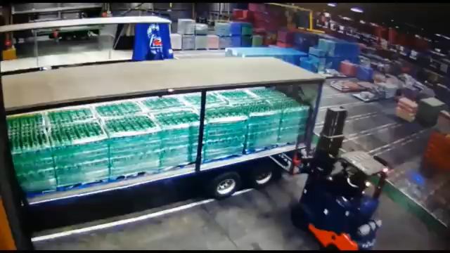
Forklift Accident Video

Slide 54
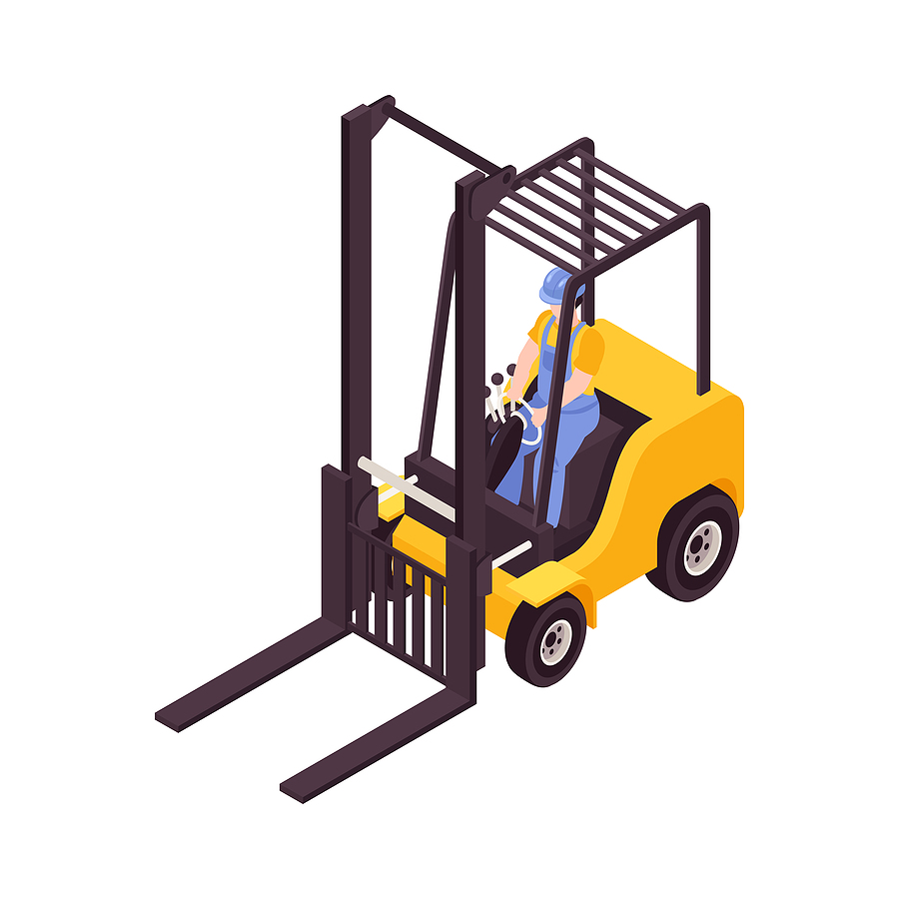

Safe Operating Practices
If your sit-down forklift is tipping over:
Never jump out of the forklift.
Plant your feet on the forklift’s floor.
Grasp the steering wheel.
Lean forward and away from the impact.
Always wear your seat belt!
Tip-over procedures may differ in other types of forklifts.

Slide 55
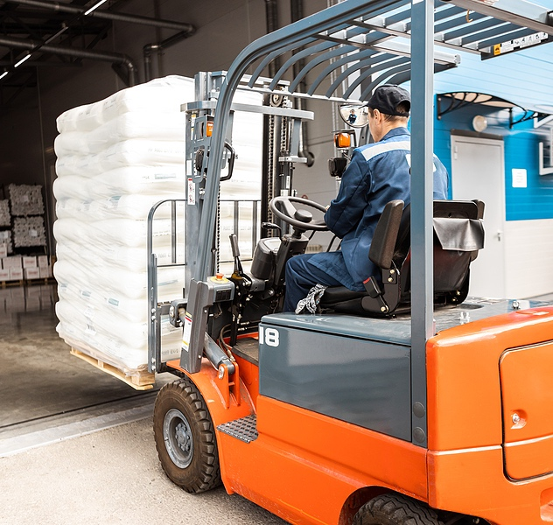
Safe Operating Practices
Forklift Specific Challenges:
Variable weight
Lack of suspension
Rear-wheel steering
Long stopping distance

Slide 56
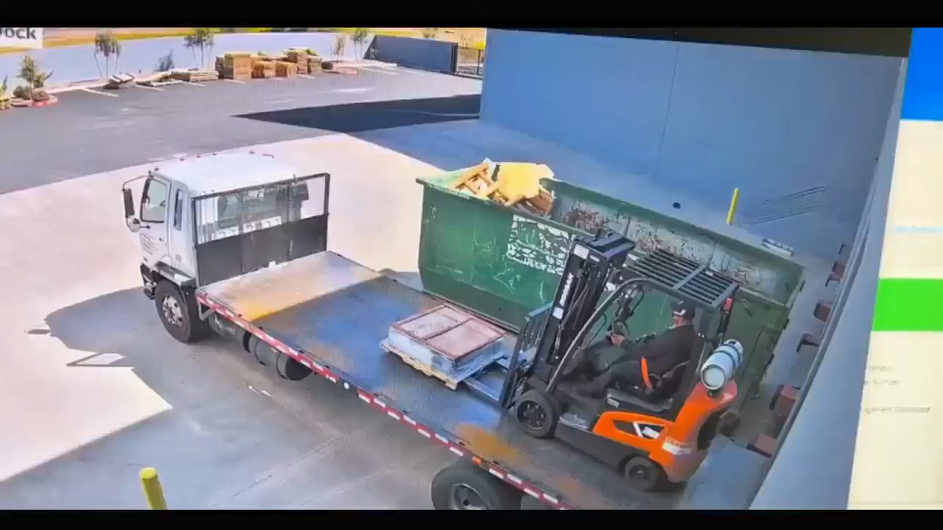
Forklift Accident Video

Slide 57
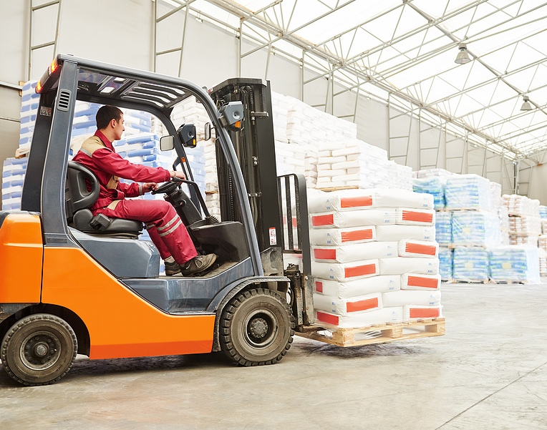
Safe Operating Practices
When driving a forklift with a load
Tilt the mast back while traveling.
Carry the load as low as possible.
Stop and sound the horn at blind intersections.
Drive slowly.
Look before backing up.

Slide 58
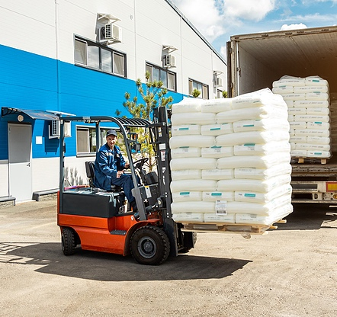
Safe Operating Practices
Driving with a restricted view:
Be aware of your surroundings.
Alert others.
Drive in reverse with large loads.
Block off area to pedestrians
Make use of a spotter.

Slide 59

Common Mistakes
Do not:
Pass at intersections.
Turn sideways on a ramp or inclined area.
Use a forklift to tow or push any vehicles or equipment.
Exceed the floor load rating.
Stick arms or legs outside of the vehicle.
Never lift someone that is standing on the forks or a pallet.
Never use bent or damaged loading pallets.

Slide 60

Safe Operating Practices
When traveling with a load.
Maintaining a safety buffer:
10 ft.
20 ft.
When traveling without a load.
Notes:
Maintain a ten-foot diameter as a safety buffer around the forklift when traveling without a load. When carrying a load, increase the diameter to twenty feet.
If you are working near overhead power lines or other electrical components, complete a hazard assessment to establish the minimum approach distance and safety controls.

Slide 61
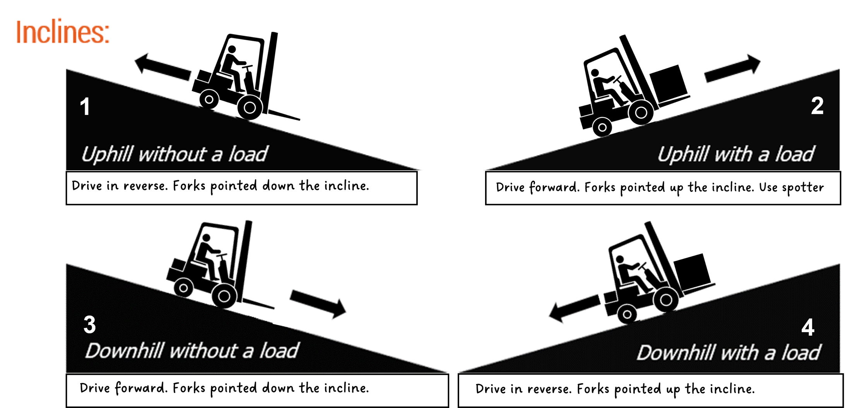
Safe Operating Practices
Inclines:
v
Notes:
Going up the incline without a load:
Drive in reverse.
Turn head and face downgrade.
Forks pointed downgrade.
Going up the incline with a load:
Drive forward.
Forks pointed upgrade.
Use a spotter if load blocks the driver's view.
Going down the incline without a load:
Drive forward.
Forks pointed downgrade.
Going down the incline with a load:
Drive in reverse.
Turn head and face downgrade.
Forks pointed up the grade.

Slide 62
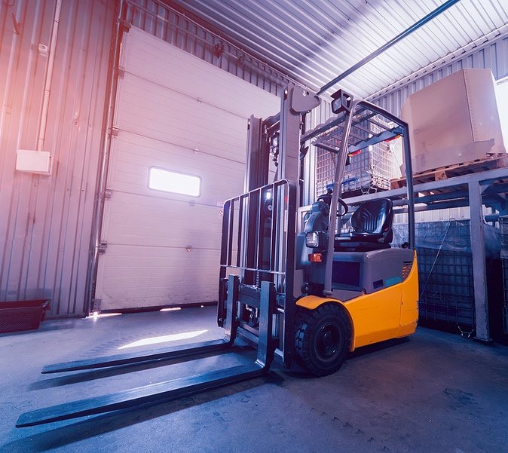
Parking – Safe Operating Practices
Lower the forks.
Turn off the engine.
Set the parking brake.
Remove the keys.
Park in: Level location.
Not blocking exits.
8+ feet from railroad tracks.
OSHA considers a forklift unattended if it’s not in view of the operator or if the operator is 25 feet or more away from it.

Slide 63
Quiz
What should you do if your forklift is tipping over?
How much of a buffer distance should operators maintain when carrying a load?
If the operator is traveling up a hill or incline with a load the forks should be pointed in what direction?
Notes:
What should you do if your forklift is tipping over?
Never jump out of the forklift.
Plant your feet on the forklift’s floor.
Grasp the steering wheel.
Lean forward and away from the impact.
Always wear your seat belt!
20 foot buffer distance will provide more time to stop when traveling with a load.
Forks pointed upgrade. Use a spotter if load blocks the driver's view.

Slide 64
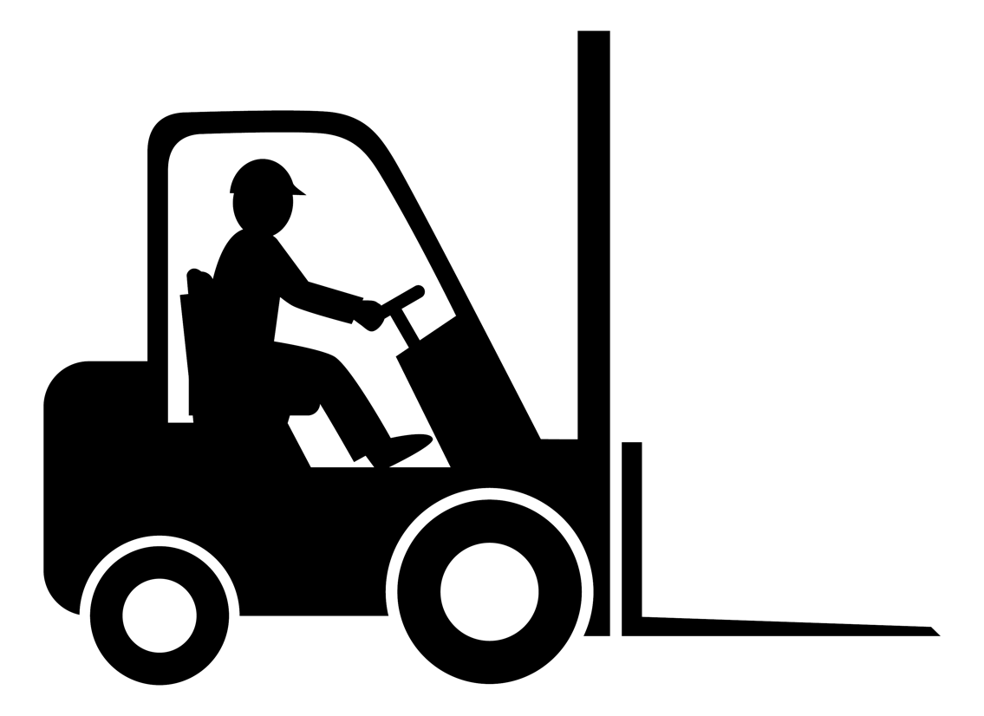
Loading and Unloading Practices
Loading
Examine the material.
Arrange the load for stability:
Place the heaviest items against the back.
Set the forks as wide as safely possible.
Never use a counterweight to balance out a load.
Heavier Item

Slide 65
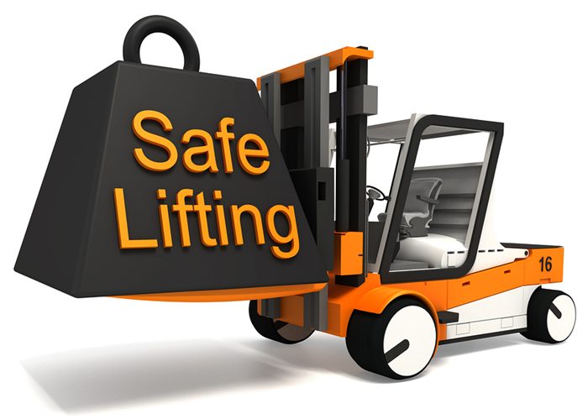
Loading and Unloading Practices
Loading
Approach the load slowly and directly.
Keep the mast vertical until the load is resting against the backrest.
Lift the forks high enough to clear the floor and then tilt them back.

Slide 66
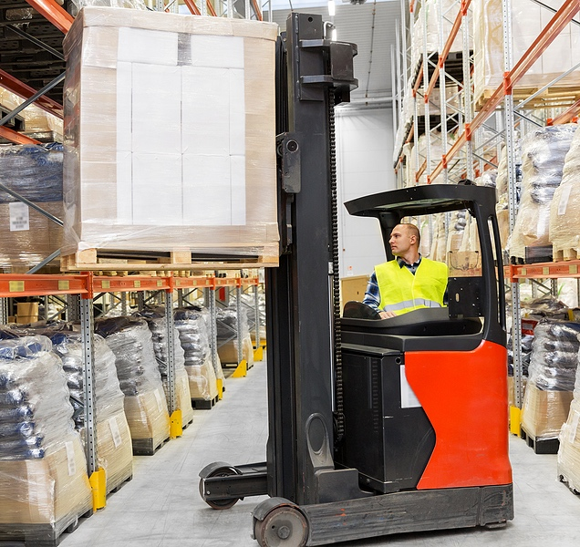
Loading and Unloading Practices
Unloading
Move forklift into position before raising the mast.
Verify that the load is stable.
Tilt the load forward only when it is in position.
Back out slowly with the mast still raised and level.
Lower the mast when clear.
Never allow anyone to walk, stand, or pass under a raised load.

Slide 67
Quiz
Why should we never use a counterweight to balance out a load?
Why is it important to place heavier materials against the back of the carriage and back rest?
Why is it important to never allow anyone to walk, stand or pass under a raised load?
Notes:
Forklifts are made to lift specific maximum loads. Changing the counterweights could cause an accident.
To stabilize the load and stabilize the forklift. The closer that heavier materials are to forklift’s center of gravity the less likely it will tip over.
Walking, standing or passing under a raised load can result in someone being struck by a falling object or struck by a moving forklift.

Slide 68

Reading Capacity Plates Video

Slide 69
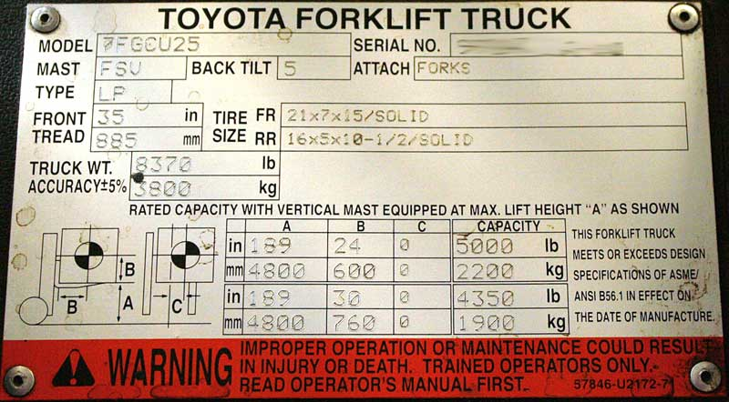
Reading Capacity Plates
Capacity/data plates
Capacity plates are often found on the instrument panel of the forklift PIT
Tells the user what loads are safe to lift
Required on all lift equipment.
If missing or illegible, immediately pull the vehicle from service.
Notes:
Capacity plates are required on all lift equipment.
If the capacity plate is missing, pull the vehicle from service until a new plate can obtained from the manufacturer.
Model number: The model number of your Toyota forklift contains a lot of useful information. For example, a 7FGCU25 has a 5,000 lb carrying capacity at a 24” load center.
Serial Number: The serial number + model number allows forklift service technicians to match parts and know a few particulars about your lift truck.
Mast Type: Toyota has various types of forklift masts, including 2-stage, 3-stage, and 4-stage. The one you use will depend on your application needs and the forklift model you choose.
Fuel Type: This indicates whether the machine is powered by electricity (E), liquid propane (LP), diesel (DS), gasoline (G), or compressed natural gas (CNG).
Back Tilt: This number represents the degrees back the mast can tilt to help keep loads on the forks securely (5 degrees in this example).
Attachments: This lets you know what attachments have been added to the forklift to give you a clear indication of its capabilities. In the pictured data plate, we see the side-shifter is in place, meaning the carriage can be shifted left or right.
Front Tread: The front tread of a forklift is equivalent to its overall width. It’s like a forklift’s footprint and helps operations managers and operators understand the space a forklift will take up in the working environment.
Tire Size: The tire size and type the truck was designed and built to use. “solid” indicates a solid pneumatic tire, whereas cushion tires will be “smooth” or “treaded.” Always replace with the same size and type of tire.
Truck Weight: The overall weight of the truck.
Forklift Diagram: The forklift diagram offers several data points that are important for understanding the function of your forklift including:
- The horizontal load center
- The vertical load center
- The maximum fork height
- The maximum distance the forks can be offset from forklift’s center line
This information can help you understand what your forklift can lift and how it can maneuver in your worksplace.
OSHA Requirement: Only trained operators who have read and understood the operator’s manual should operate forklifts.
(Source: toyotaforklift.com)

Slide 70
Reading Capacity Plates
(A) = Mast Height
(B) = Standard Load Center
CAPACITY = Maximum Load Capacity
Notes:
One of the most important sections of our forklift capacity plates is understanding the maximum load capacity of that forklift.
And Maximum Load Capacity is essentially how heavy the load can be, based upon calculations such as mast height, load center, and front tilt.
As we can see on this example data plate, we have been provided a few variables.
Column A is showing us the mast height at max height of 189 inches.
Column B is showing us the standard load center in inches at 24 and 30 inches. The load center is the distance from the mast to a load’s center of gravity.
The Capacity column is showing us the maximum capacity given those variables in columns A and B.
CLICK. So for example if were looking at the inches row that I’ve highlight here. The capacity plate is showing us a mast height at a max of 189 inches with a standard load center of 24 inches. In this case the maximum capacity for this lift will be 5000 lbs.
CLICK. Now what happens when the standard load center changes to 30 inches? What will be the maximum load capacity in this scenario?
So remember – the maximum load capacity of a forklift will be reduced even more, when the actual load center is greater than the standard load centers listed on the capacity plate.

Slide 71
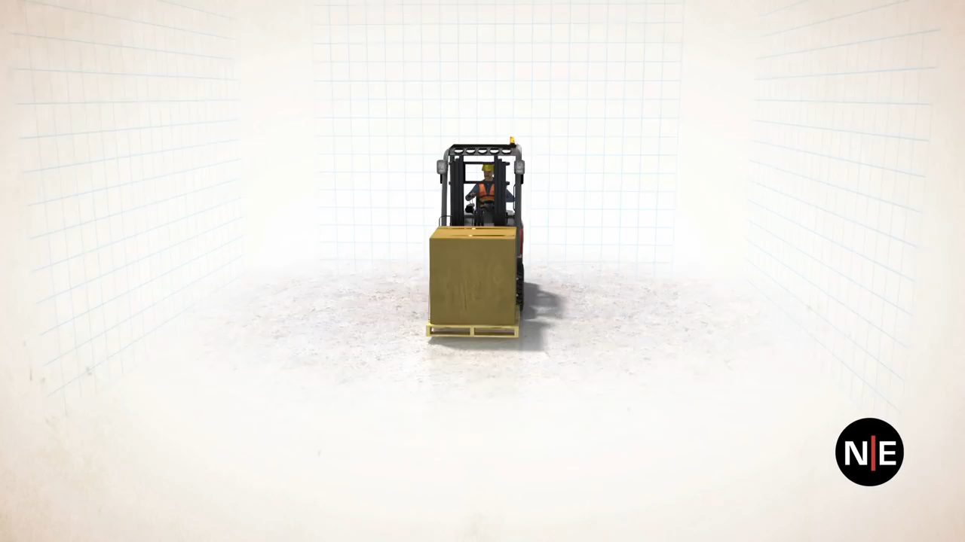
Stability Triangle Video

Slide 72
Stability Triangle
Unloaded
Forklift. CG at center of triangle.
Staying within the triangle:
Always drive slowly.
Never tilt the forks forward unnecessarily.
Tilt the load back only far enough to stabilize it.
Never drive forklift with mast extended.
Travel with the load as low as possible.
Obey the equipment’s weight limitations.
Do not run over debris or objects.
Do not make sudden stops or quick turns.
Maximum load with
mast vertical. CG at edge of stability triangle.
= Stable
= Unstable
CG = Center of Gravity

Slide 73

Load Safety Practices
Tip-Over Risk Factor
Raising the load
Adding weight
Driving fast
Stopping or turning

Slide 74
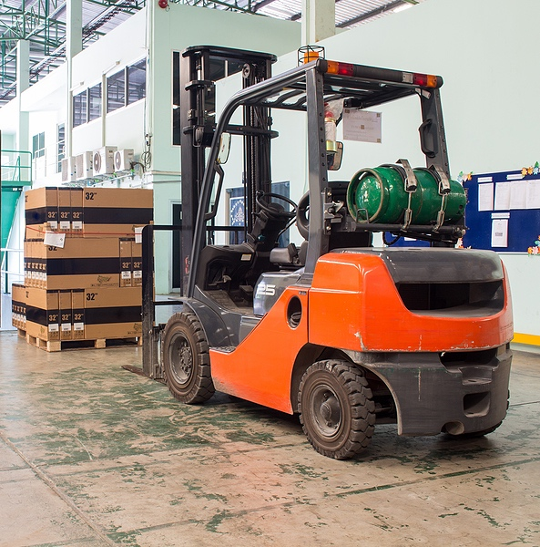
Load Safety Practices
Determining load weight
Check shipping documentation.
Check item or product.
Check weights and measures standards.
Weight of attachments or accessories.

Slide 75
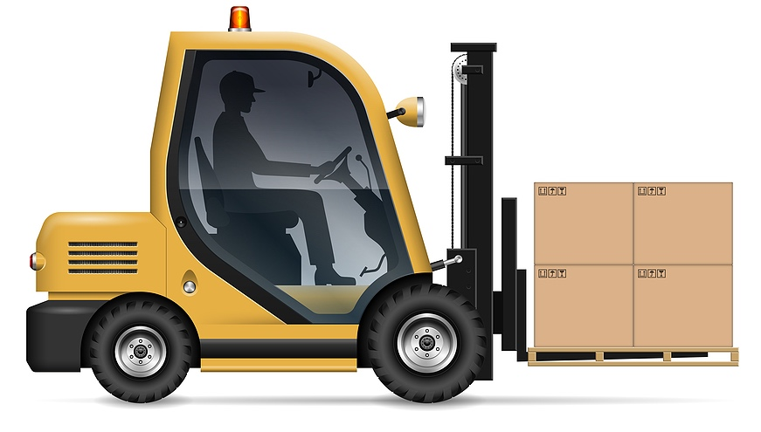
Load Center
Load center: The distance from the mast to a load’s center of gravity.
24”
Load Center
Notes:
Now let’s talk more about the load center that I mentioned in the previous slide. Remember that the load center is the distance from the mast to a load’s center of gravity. CLICK.
For most counterbalance forklifts the standard load center is 24 inches. And this is typically based off of our standard size pallets in North America which is 48” x 40” Half of the length of a 48” pallet is 24” which gives us our standard load center.

Slide 76
Calculating Reduced Maximum Load Capacity
The maximum load capacity of the forklift is reduced when the actual load center is greater than the standard load center listed on the capacity plate.
36”
Load Center
Notes:
The most important thing that we have to remember is that the maximum load capacity of a forklift is reduced when the actual load center is greater than the standard load center listed on the capacity plate. In these instances, we have to be able to calculate the new reduced maximum load capacity in order to determine if it is safe to lift the load.
Now you can teach your operators how to calculate reduced maximum load capacity or you can train a designated person to do this such as your self. You just have to make sure that your forklift operators understand that if the actual load center is greater than the standard load center then we need to stop and take time to perform the new calculations. Again your forklift operator can do this if you have trained them or you can be that designated person.

Slide 77
Calculating Reduced Maximum Load Capacity
First calculate the maximum inch pound capacity of the forklift: (distance from axle to mast + standard load center) x listed maximum load capacity
Then calculate the reduced maximum load capacity: maximum inch pound capacity / (distance from axle to mast + actual load center)
Notes:
So what is the process for calculating the reduced maximum load capacity when the actual load center is greater than the standard load center.
Calculating the reduced maximum load capacity of a forklift is a two-step process:
CLICK 1. First, we have to calculate the maximum inch pound capacity of the forklift.
To calculate the maximum inch pound capacity of the forklift
CLICK We have to add the distance from the axle to the mast to the standard load center and multiply that, by the listed maximum load capacity
2. CLICK. And once we have that maximum inch capacity number we can now calculate the reduced maximum load capacity.
CLICK this will require us to add the distance from axle to mast to the actual load center and dividing this number into the maximum inch pound capacity.
This will give us the reduced maximum load capacity that were looking for.

Slide 78
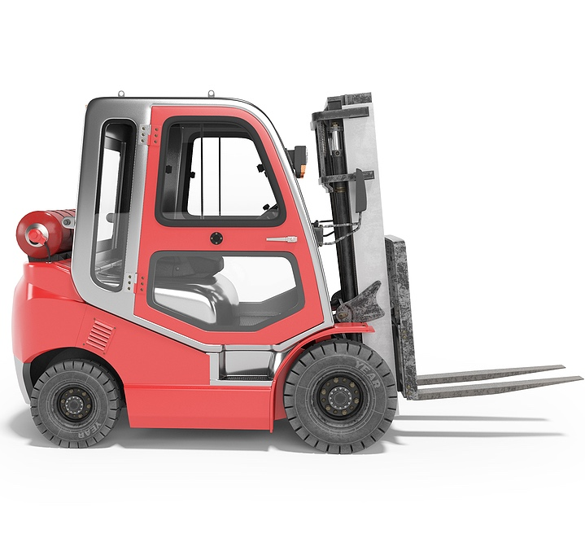

Sample Problem
Reduced Max
Load Capacity
5,000 lbs. max
18”
24”
36”
Notes:
For example, let’s say you operate a forklift that has a maximum load capacity of 5 thousand pounds at a standard load center of 24 inches. CLICK
The distance from the axle to the mast on the forklift is 18 inches. CLICK
If you were going to lift an item that has a load center of 36 inches, CLICK what would the reduced maximum load capacity of the forklift be?

Slide 79
Maximum Inch Pound Capacity
First calculate the maximum inch pound capacity of the forklift: (distance from axle to mast + standard load center) x listed maximum load capacity
(18 + 24) x 5000 = 210,000 maximum inch pound capacity
5,000 lbs. max
18”
24”
Notes:
So remember, First, we have to calculate the maximum inch pound capacity of your forklift.
CLICK That’s going to be (distance from axle to mast + standard load center) x listed maximum load capacity
In this case it’s going to be
CLICK
18 inches from the axle to the mast added to 24 inches for the standard load center and multiplied by the listed maximum load capacity of 5 thousand pounds equals a 210,000 maximum inch pound capacity.

Slide 80
Reduced Maximum Load Capacity
Then calculate the reduced maximum load capacity: maximum inch pound capacity / (distance from axle to mast + actual load center)
210,000 / (18 + 36) = 3,888.88 lbs.
Always round maximum load capacity figures down.
5,000 lbs. max
18”
24”
36”
Notes:
And once we have our maximum inch pound capacity we are now ready to rock and roll. We can now go to step 2 and use this information to calculate the reduced maximum load capacity of your forklift.
CLICK this will require us to add the distance from axle to mast to the actual load center and dividing this number into the maximum inch pound capacity.
In this case it’s going to be
CLICK
18 inches from axle to mast plus 36 inches for the load center of the actual load equals 54. When you divide 54 into the maximum inch pound capacity of 210,000 you get 3,888.88, which should be rounded down to a reduced maximum load capacity of 3,888.
CLICK Always round our maximum load capacity figures down.

Slide 81
Final Reduced Maximum Load Capacity
Answer:
3,888 lbs. max
5,000 lbs. max
18”
24”
36”
Notes:
So the new reduced maximum load capacity of the forklift in this example would be 3,888 pounds when lifting an item with a load center of 36 inches.
Any total load weight below that amount would be within the acceptable range for the forklift.
Keep in mind that field calculations such as these should be done for estimation purposes only and factors other than weight, such as load instability, attachments, inclines, etc that could make a load unsafe to lift.

Slide 82
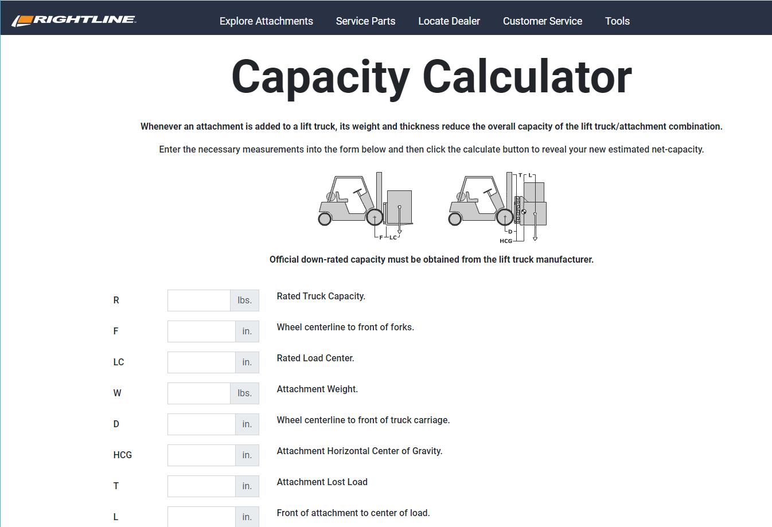
Capacity Calculator
www.rightline.com/capacity
Notes:
Click on the link to view the capacity calculator

Slide 83
Quiz
What is the standard load center for most counterbalance sit down forklifts?
What is meant by maximum load capacity?
What happens to the maximum load capacity on a forklift when the load center increases?
Notes:
For most forklifts the standard load center is twenty-four inches, but it can vary.
How heavy the load can be, based upon calculations such as mast height, and load center, and front tilt.
Maximum load capacity decreases

Slide 84
Pedestrian Safety Practices
Forklift operators and pedestrians use eye contact
before proceeding.
Always give pedestrians the right of way.
Operators must know where pedestrian traffic areas
are located.
Pedestrians must receive safety training.
Separate pedestrians from forklift traffic
  Use painted yellow lines, yellow floor tape,
  barrier systems
Use convex mirrors at blind intersections.
36%
36% of fatalities are pedestrians
Notes:
According to OSHA approximately 36% of forklift related fatalities are pedestrians
This is important because if we have employees or visitors that may work around our forklifts then the risk for a struck by accident increases tremendously.
To comply with OSHA but more importantly reduce risk of an accident, we have to ensure that our operators receive training on where pedestrian traffic areas exist.
We also need to provide pedestrian safety training for those employees exposed to forklift traffic. Pedestrians need to know where they are more likely to encounter moving forklifts.
In addition to operator and pedestrian safety training we should implement administrative and engineering controls that will reduce the risk of struck by accidents. We should:
Identify pedestrian walkways and forklift pathways. This can be done by painting or stenciling in yellow lines on floors that will visibility identify forklift pathways and pedestrian walkways.
Use convex mirrors at blind intersections
Use mirrors on forklifts. Mirrors are a great way for forklift operators to quickly get a visual of their surroundings.

Slide 85
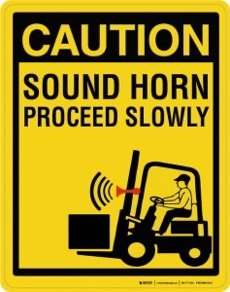
Pedestrian Safety Practices
Use mirrors on forklifts.
Retrofit forklifts with pedestrian warning lights.
Make sure forklift back up alarms are working.
Before going through a blind intersection:
  Stop and use horn before proceeding
Use a spotter when driving with a restricted view.
Follow forklift warning and caution signs.
Close off high forklift traffic areas to pedestrians.
Notes:
Retrofit forklifts with pedestrian warning lights. These lights are great ways to give pedestrians a heads up that a forklift is nearby.
Make sure that forklifts have back alarms and horns being used at blind intersections. This gives pedestrians more time to anticipate and be more cautious when around forklifts.
Implement a policy that requires the use of spotters when a forklift operator has to drive with a restricted view.
And be sure to use forklift warning and caution signs. These will warn operators and pedestrians of pedestrian and forklift traffic areas.

Slide 86
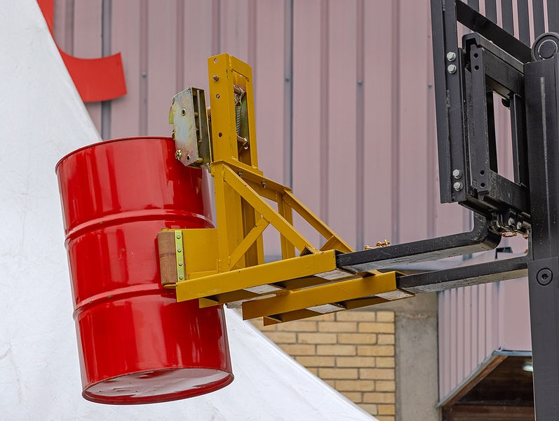
Forklift Attachment Safety
Forklift Attachments
Only use attachments approved by the forklift PIT manufacturer.
Know the weight limits of attachment.
Ensure capacity plates are posted on the attachment.
Never attach slings, cables, or chains to the forks.
Read the attachment owners manual

Slide 87

Forklift Attachment Safety
Work Platforms
Used to raise employees
Must be designed and certified by manufacturer or professional engineer
Securely attached to the forks
Must be equipped with:
Guardrails
Fall protection
Signs showing capacity
The operator must remain at the controls at all times
Always exit the work platform before moving the forklift.

Slide 88

Forklift Operator Evaluation
The forklift operator evaluation is required by OSHA.
Evaluation will help us identify deficiencies and opportunities.
Evaluation will be conducted by qualified person with experience operating forklifts.
Operator will be observed performing normal forklift duties in their work environment.
Evaluation will help us determine if refresher training is needed.

Slide 89

Forklift Operator Evaluation Form
Notes:
This is a copy of the forklift operator evaluation form we will be using to complete your forklift evaluation.

Slide 90


Watch Forklift Operator Safety Video
Notes:
Click on the video image to play the forklift operator safety video for students.
This video will take approximately 18 minutes

Slide 91
QUESTIONS?

Slide 92
THANK YOU!
Instructor Name
Instructor Phone Number | Instructor E-mail Address

